Slide 1
Finding and Converting an Authentic Language Sample into Teachable Material
Divya Chaudhry, Ph.D.
Jayoung Song, Ph.D.

Slide 2
Presentation Overview
1. Establishing usefulness of authentic material in class
2. Finding sources of authentic data
3. Organizing authentic data
4. Example of data to teaching
5. Hands-on activity

Slide 3
Establishing Usefulness of Authentic Material in Class
Unnatural language sample vs. Authentic language sample
Michael: Hi. I am Michael Jung. What is your name?
Sophia: I am Sophia Wang. Nice to meet you.
Michael: Are you Korean?
Sophia: No, I am not Korean. I am Chinese.
Michael: Ah, really? I am Korean.

Slide 4
Establishing usefulness of authentic material in class
Unnatural language sample vs. Authentic language sample
S: Hi.
H: Hi.
S: Uh, what is your name? (honorific)
H: Ah….I’m… Han.
S: Ah yeah…I am Jayoung.
H: Ah yeah really? where are you from?
S: Ah yeah..I am from Korea.
H: Ah…
S: Where are you from? Are you Korean?
H: Yes, yes.
S: Ah yeah.
H: What brought you here?
Notes:
We want our students to make informed choices about the language. Authentic data allows students to do that.

Slide 5
Converting authentic data to teachable material
Collect language data

Slide 6
Finding Sources of Authentic Data
Audio-recorded authentic conversations
Video recordings of authentic conversations
Scripted media found on the internet
Scripted interactions (e.g. giving native speakers a prompt and having them enact a situation- resulting conversation can then be used in class)
Corpus of authentic language data(e.g.: http://www.c-oral-brasil.org/ - for Portuguese)

Slide 7
Finding Sources of Authentic Data
accessible at:
http://clicmaterialsld.blogs.rice.edu/
links shared on accompanying handout for Module #2

Slide 8
Organizing Authentic Data
Language Data → Teaching Objectives
Teaching Objectives → Language Data

Slide 9
Converting Authentic Data to Teachable Material
Collect language data
Analyze language data for different linguistic topics

Slide 10
Organizing Authentic Data
File name | Parts selected | Topics of conversation | Grammar/Vocab | Communicative features | Links with textbook
Tutor teacher convo | 7.27-11.21 | small talk: how was weekend, internship plans, summer plans | "nahin?" , rephrasing the other person's response "bade logon ka school" | greeting, asking for permission to talk, topic expansion, elaboration, keeping conversation going ; clarifying confusion, listener feedback, seeking more information; cracking jokes
 | 16.31-18.34 | comparison of Indian classrooms with Rice classrooms | discourse markers for comparison; "main aapki baat samajh raha hoon" | express opinions ; reject suggestions
With friends over dinner | 8.00-9.22 | Ordering wine in a restaurant |  | asking for preference, giving suggestions
 | 34.17- 36 | helping a friend, friend in love, funny story, Indian families, scolding | idiomatic expressions, narration, interweaving of the past and present tense in narration, informal conversation | topic development, giving feedback, turn-taking (overlaps , listener feedback), teasing
 | 36.15- 37.06 | Exchanging personal background information | present imperfective, past habitual tense | repair, listener feedback, talk development | Ch 12 dialogue (where did you grow up)
 | 38.31- 39.05 | what were you doing in 2009 | past tense- progressive, perfective |  | Ch 14 (Prog tense)
 | 43.43- 45.02 | planning a trip to Colorado | politeness through use of 'sakna' verbs | giving suggestions | Ch.19 – aux verb saknaa

Slide 11
Organizing Data from a TV Show
 | Parts Selected | Grammar/Vocab | Communicative Features | Sociocultural topic | Link | Links with textbook | Notes
HHH Ep 4 | 18:28- 21:21 | present prog (nice- "tum chup raho") | Ordering food in a restaurant | Students working part-time in a restaurant | https://youtu.be/X9ZDag8he2A |  | Also recordings from HIND 106 Fall 2016; also see discussion below
HHH Ep 5 | 1:09- 1: 49 (recap) | past indef tense, past prog |  |  | https://youtu.be/UZcAv6WZtn4
HHH Ep 5 | 2:13-2:33 | past perf , past prog | narrating an incident (gossip); listener feedback |  | https://youtu.be/UZcAv6WZtn4 | Ch.12 (indef)
HHH Ep 5 | 8:24- 9:00 | "mere khyaal se, kyun, " | discussion, Agreement/disagreement | Students working part-time in a restaurant | https://youtu.be/UZcAv6WZtn4
HHH Ep 5 | 11:57- 12: 43 | "nahin toh" | Not participating in a conversation (silence, nahin toh, ) |  | https://youtu.be/UZcAv6WZtn5
HHH Ep 5 | 13:51- 17: 12 | "pata hai ek baar kya hua" ; past indef, imperative | narrating a story to someone to serve as an advice/example | Hindi mythology- naarad, bhakti | https://youtu.be/UZcAv6WZtn6 | Ch 8 (imperatives), Ch 12 (indef)
HHH Ep 5 | 17:27-17:39 |  | making a phone call to a friend's house |  | https://youtu.be/UZcAv6WZtn7
HHH Ep 5 | 17:43-18:03 |  | answering a phone call |  | https://youtu.be/UZcAv6WZtn8
HHH Ep 7 | 6:08- 6:24, | future tense, prog, | making a request to a teacher |  | https://youtu.be/UtEY5HZioho

Slide 12
Converting Authentic Data to Teachable Material
Collect language data
Analyze language data for different linguistic topics

Slide 13
Example of Data to Teaching : Korean
Step 1: Pre-activity: Raising awareness of language feature
Data 1: Conversation between Jeremy & Connie
https://mediacosmos.rice.edu/Watch/Zg6k3Q4N
Goal-__________________________________________
Understanding English Listener Feedback
Notes:
Start with how did you collect the data
The textbook talks about how to speak but not how to listen. But this is what happens in a real conversation.

Slide 14
Example of data to teaching : Korean
J: Nice to meet you.. What are some of your hobbies?
C: Uh, I like to go swimming and read during my free time. What about you?
J: Oh that’s cool, my friends and I like to go shopping together and as well as sight seeing
C: Mm.
J: Yes.
C: Where do you want to travel then?
J: Oh, I really want to go to Korea.
C: Oh, so uh, you’ve never been to Korea before?
J: No, have you been to Korea? C: Yeah, I actually went last year as an exchange student.
J: Really? How was it?
C: It was really really nice.
assessment
acknowledgment

Slide 15
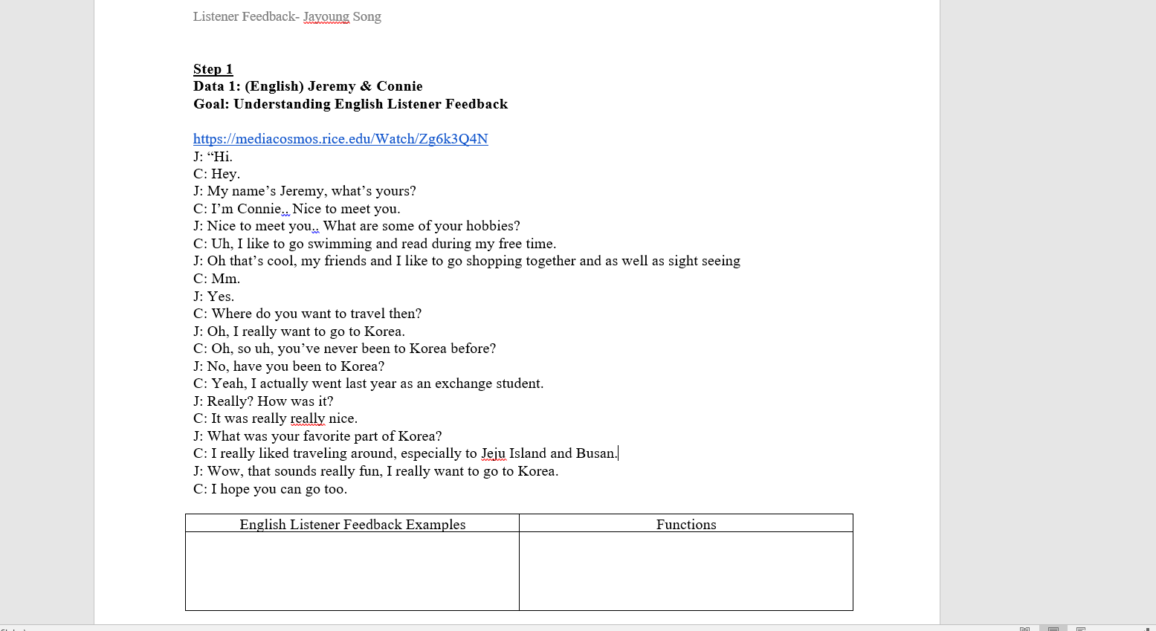
Example of data to teaching :Korean
Step 1: Pre-activity: Raising awareness of language feature

Slide 16
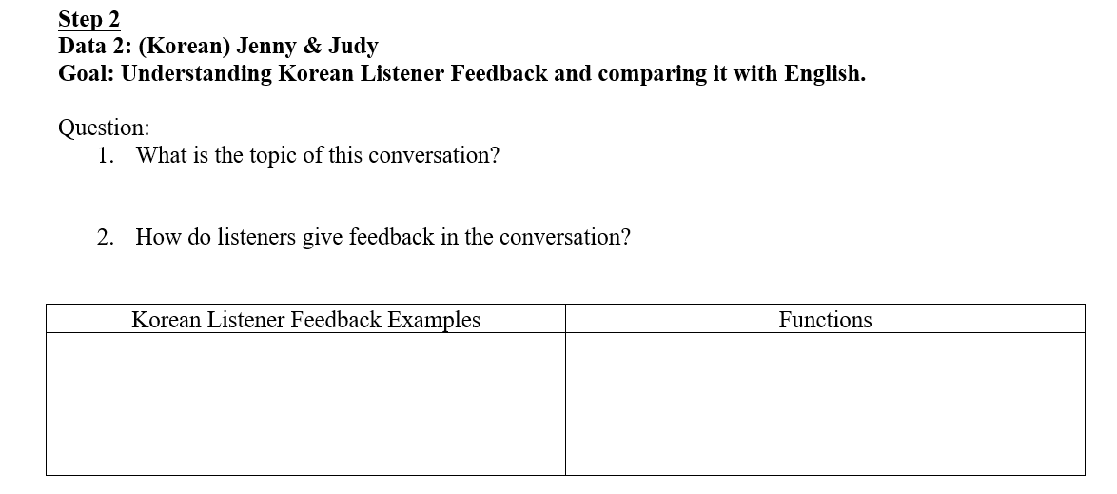
Example of data to teaching :Korean
Step 2: Use of authentic data: Analysis of Korean conversation

Slide 17
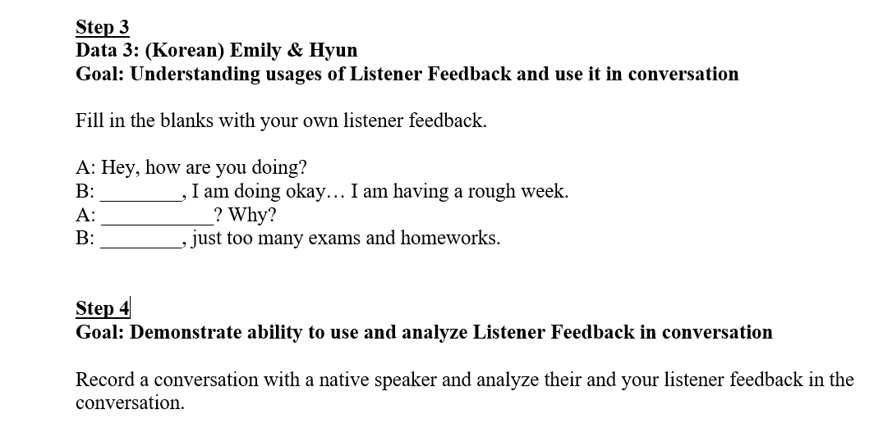
Example of data to teaching :Korean
Step 3: Application by the students of the target objective
Step 4: Assessment activity to test students’ learning of the target objective

Slide 18
Converting Authentic Data to Teachable Material
Collect language data
Analyze language data for different linguistic topics
Pre-activity (prepare students to work with the data)
Main activity using authentic data
Application of target objective by the students
Assessment activity to test students’ learning of the objective

Slide 19
Summary: Authentic Data→ Teaching Material
Audio recorded conversations with native Korean speakers (students; tutors ‘act out’)
Listener feedback
Raising awareness of the conversational feature in English
Guide students to identify the function of the conversational feature in Korean
Practicing the structure in speech or fill-in-the blank exercises
HW: interaction with native speakers and analyze and reflect on the features incorporated with them
Assessment activity to test students’ learning of the objective
Collect language data
Application of target objective by the students
Analyze language data for different linguistic topics
Main activity using authentic data
Pre-activity (prepare students to work with the data)

Slide 20
Final Thoughts on Using Authentic Data in the Language Classroom
Yes, using authentic data in the language classroom IS time-consuming
Practice principled pragmatism:
Use authentic materials where you can use it to meet your needs and the needs of your learners

Slide 21
Questions

Slide 22
Hands-on Activity
Split into smaller groups by language
Do #8 on the handout: language analysis
You are given transcripts of three language samples
Analyze the samples for language topics that you can teach in your classroom for your students.
Do #9: activity design
Select one language sample that you would like to use in your classroom and design 4 activities for it (see handout)
Do #10: data→ teaching
Now YOU search for data on one of the links provided
(Think about where you wan to start? At the objective or let data speak to you?)
How would you transform data → teachable material?
Do #11: reflection
Share your challenges in using authentic data for your classroom.

