Slide 1
Approaching written vs. oral authentic materials
Raising awareness of differences in spoken and written language
Fatima Baig & Katharina Kley

Slide 2
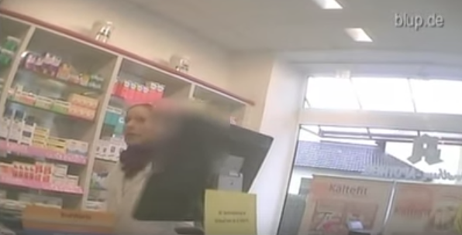
Authentic materials
Video: Survey… What does “Heimat” mean to you?
Video: Pharmacy test
Text messaging: Making arrangements

Slide 3
WHAT TO TEACH?
SPOKEN VS. WRITTEN LANGUAGE

Slide 4
Written vs. spoken language: German examples (Lightfoot, 2016)
Omission of subjects | [ ] Muss gehen. | [Ich] muss gehen. | [I] have to go.
Omission of verbs | Ich muss nach Hause [ ]. | Ich muss nach Hause [gehen]. | I have [to go] home.
Omission of word endings/ beginnings | Ich hab’, Wir könn’ Wir schicken ‘nen zweiten. | Ich hab[e], Wir könn[en] Wir schicken [ei]nen zweiten. | I have, we can We send a second one.
Omission of internal sounds of words | Ich hab’ g’rade gehört. | Ich habe g[e]rade gehört. | I have just heard.
Omitted sounds as contractions | Gibt’s... | Gibt es... | There is...
Sounds fusing/ blending | Ham Hastu Haste | Ham = Haben Hastu = Hast du Haste = Hast du | To have You have
Verb placement in subordinate clauses | ...weil das Wetter ist schön. (V2) | ...weil das Wetter schön ist. (Vfinal) | ... because the weather is nice.

Slide 5
Examples from other languages
Language | Written | Spoken
Spanish | ¿Para dónde vas? | ¿Pa dónde vas?
Chinese | Ni jiao shenme mingzi? "What is your name?" | Ni jiao shenme mingzi a? (discourse particle "a" softens the tone of the question)
French | Ce n'est pas possible! | C'est pas possible!
Korean | Jeo Neun Kimchireul Joahaeyo. (“I like Kimchi” with object marker) | Jeo Neun Kimchi Joahaeyo. (“I like Kimchi” without object marker)

Slide 6
HOW TO TEACH?
TASK EXAMPLES

Slide 7
Data Analysis Task: Noticing
Have a closer look at what the people say. Answer the questions with a partner:
All these people talk about themselves. Have a look at the verb endings.
Find the main and subordinate clauses in the following statements. What do you notice?
Person 1: “Da, wo ich mich wohl fühl, da, wo meine Freunde sind, wo mein Zuhause is.”
Person 6: “Wo meine Freunde leben. Stuttgart.”
Person 7: “Ja, wo man aufgewachsen is.”
Person 6: “Wo meine Schule is.”
Find the subject in the following statement. What do you notice?
Person 8: “Bin Ausländerin.”

Slide 8
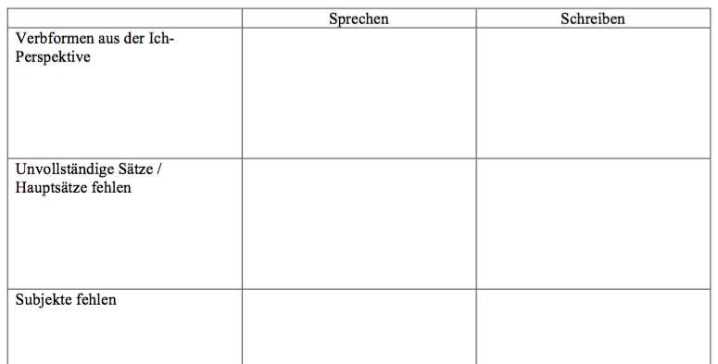
Data Analysis Task: Identifying written forms
Complete the table with a partner. (a) Write the sentences from the survey in the appropriate “Sprechen” column. (b) How would you write these sentences?

Slide 9
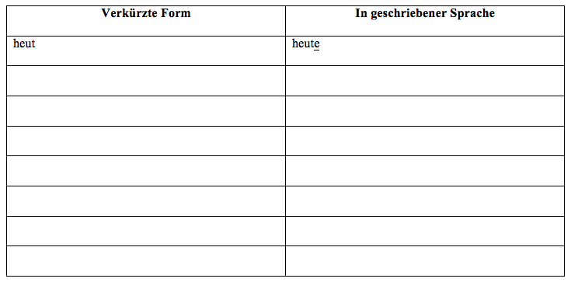
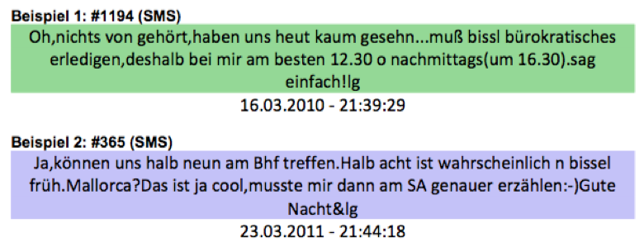
Data Analysis Task: Finding short forms
Short forms do not only exist in spoken language but also in text messaging. Read the text messages below. (a) Find the short forms and write them in the table. (b) How would these forms look like in a newspaper article or a story?

Slide 10
Listening Task: Recognizing words
People in Stuttgart were asked what “Heimat” means for them. Watch the video and write down all the words that you recognize. Compare the words that you heard with the others in class. Link to the Video.

Slide 11
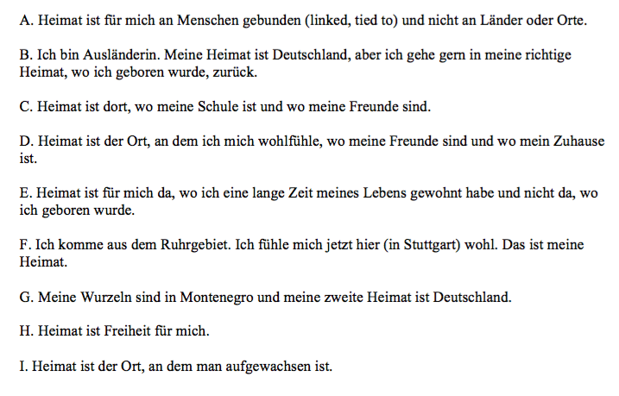
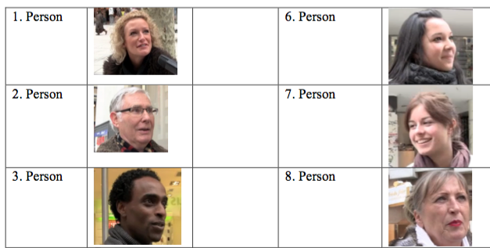
Listening Task: Matching
Watch the video again. Who says what? Match the statements on the left with the people on the right.

Slide 12
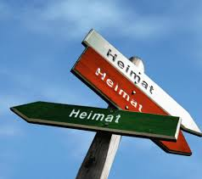
Speaking Task: Talking about one’s own opinion
What does Heimat mean to you? Discuss with a partner. Share your opinions with the others in class. You can use some of the expressions that you have seen the German speakers use to answer that question.

Slide 13
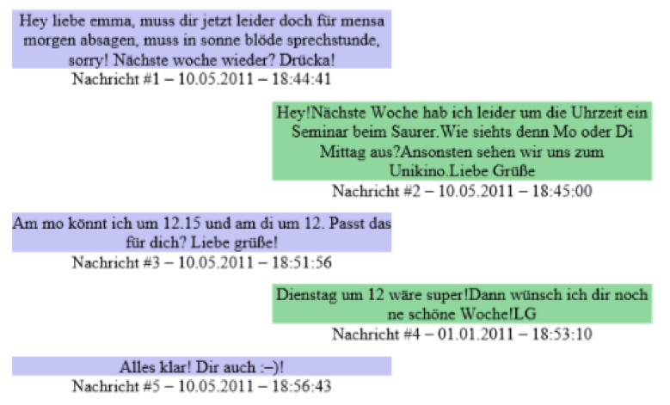
Reading Task: Comprehending text content
Read the second text message interaction again and answer the questions.
Why can’t Emma meet next week at the same time?
Emma and her friend have decided on a new day and time. When will Emma meet her friend?
What will they do together?

Slide 14
Writing Task: Writing their own text messages
Now it’s your turn. Find a partner and exchange phone numbers, in German, of course :-) ! Write each other text messages and make arrangements to meet this weekend. Discuss when and where you want to meet and what you want to do. Use some of the short forms that we found in the German examples.

Slide 15
Now it’s your turn…
Have a look at the activities on your handout.

