Slide 1
Connecting Textbooks
to
Authentic Data
Aymará Boggiano & Luziris Pineda Turi
Notes:
1

Slide 2
Outline
Define authentic material
First Year Spanish Sample
Second Year Spanish Sample

Slide 3
Enhancing Your Textbook
Limitations of textbooks materials
Scripted
Slow pronunciation
Extremely modified
What is meant by the word “authentic”.
Are you already using some?
Written vs. spoken

Slide 4
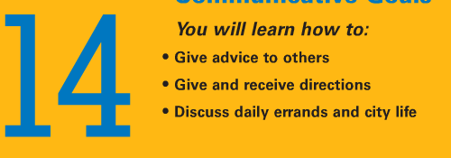
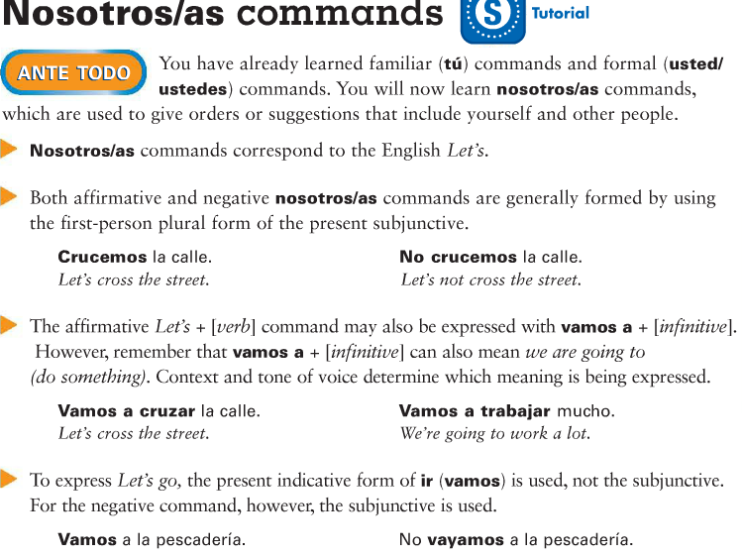
Sample 1: Beginner Spanish
The importance of “us” commands.
Why do textbooks wait so long to teach commands for “us”?
How do Spanish-speakers
actually command for the
“us” form?

Slide 5
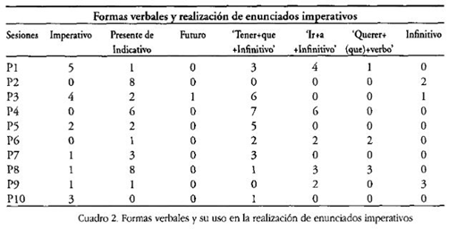
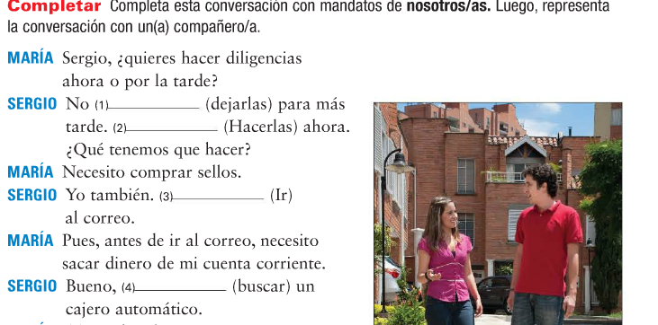
Some research and a lesson
When to teach commands for “us”?
Which form to teach?
Contextualized use.

Slide 6
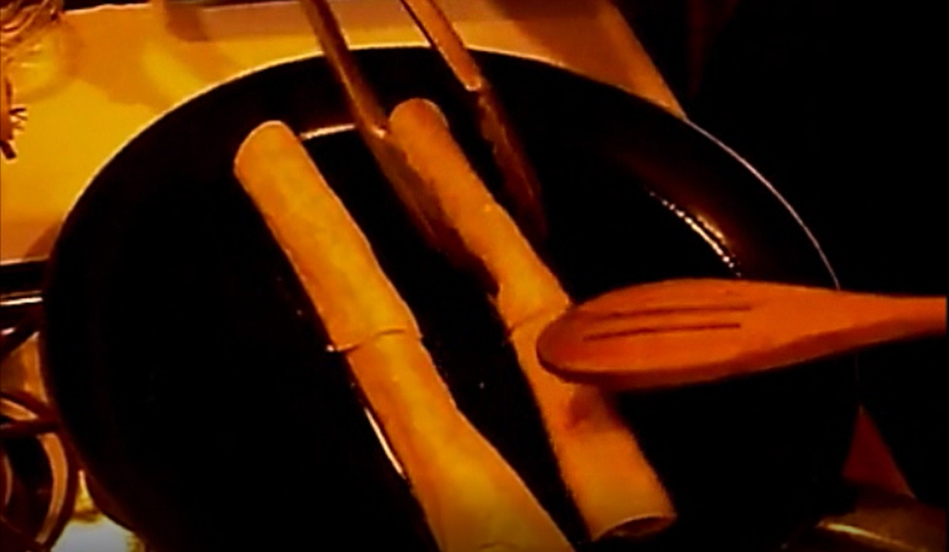
The Lesson Plan
Contexts for using “us” commands.
Youtube videos
Cooking
Braiding
Pilates
Transcription and enhancement

Slide 7
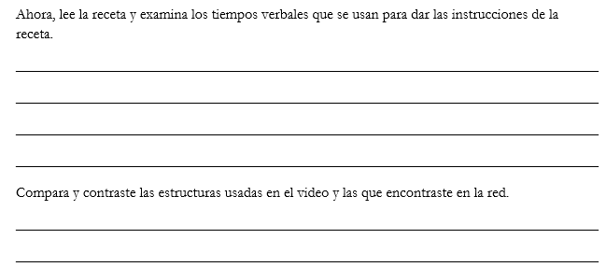
The Lesson Plan Cont.
Steps
Warm-up: Have students think of a dish and instruct each other orally on how to make it.
Pre-viewing: Fill-in transcripts before listening (hypotheses about verb tense used)
While viewing: Listen and fill-in with actual audio.
Post-viewing:
Compare and contrast
Identify patterns

Slide 8
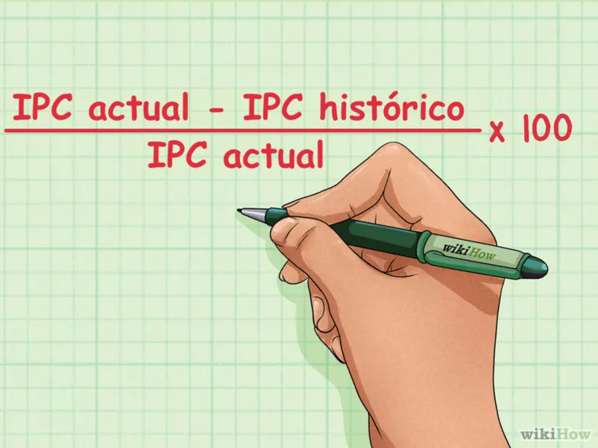
Sample 2 Intermediate Spanish
Inflation: Calculating it and its consequences
1. Main source: Vocabulary and Content
Activities:
Reading comprehension
Classify words
Use vocab in fact finding: Sign here.
Using content: Calculate inflation in the U.S
Dictogloss: Effect of inflation in your salary
Calculo de la Inflacion

Slide 9
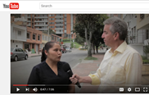
2. Grammar Support: Video-Dialogue: Use of negatives
Activities:
Activating previous knowledge:
Conversation using same questions asked in video
Listening comprehension with enhanced input
Negating: Use transcription to compare and infer new uses of known concept: How to negate
Mini-Conversation with an observer: Three situations to discuss using vocabulary and grammar

Slide 10
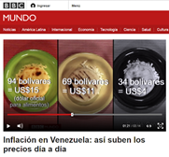
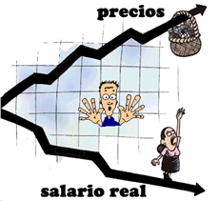
3. Other Authentic Materials
Web Site: How much is your hamburger?
Video: BBC-Mundo Changes in the price
of the arepa
Activity: Compare prices of hamburger and arepa.
Short article & map: Inflation in Latin-America.
Activity: Short reflection comparing rates and consequences.
Google images
Activity: What is inflation?
Draw a picture and short paragraph to explain

Slide 11
Conclusion
1.Vocabulary & Grammar:
New vocabulary as used by native speakers in the real world
Grammar concepts using real world examples
Grammar usage in new ways and contexts beyond textbook
2. Language analysis & Expanded use of the target language
Analyze target language usage in contrast with their own.
Transition from the classroom to the real world.

