Slide 1
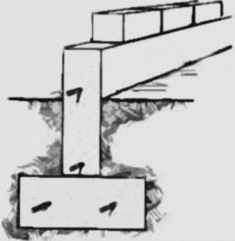
Devising Student Learning Outcomes for Teaching Interactional Competence
Rue Burch
April 6th, 2017
CLIC Faculty Workshop

Slide 2
Student Learning Outcomes, Goals, Objectives
… apply to …
Individual Lessons & Tasks
Units or Series of Lessons/Tasks
Course Syllabi
Course Sequences / Curricula
… help to …
Specify Expectations → Assessment
Provide a Framework for Planning
Provide Common Ground for Sharing Plans and Materials
Articulate between Levels and Courses
Evaluate Our Successes and Identify Areas for Improvement

Slide 3
Student Learning Outcomes, Goals, Objectives
Formulating
SLOs need to …
Be Active, Concrete, Measurable
Focus on action and product, not on “knowledge” →
“The student will…”
(Focus on DOING)
Avoid psychological predicates such as…
… “learn”
… “understand”
… “remember”

Slide 4
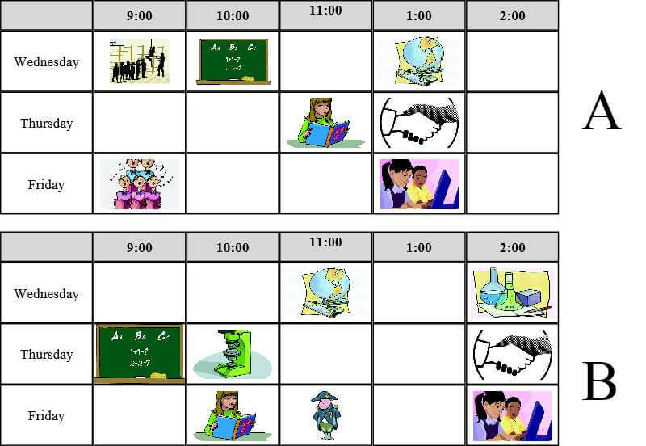
Example: Information Gap Task
Source: http://www.engames.eu/school-subjects-speaking-activities/

Slide 5
Example: Information Gap Task
The students will be able to understand
how to ask about each other’s schedules
The students will ask clarification questions
The students will ask questions about each other’s schedules
using examples such as
“What are you doing next [DAY] at [TIME]?”
“When is your [SUBJECT] class?”
“What about [DAY&TIME / SUBJECT]?”
“When are you free?”
The students will repair difficulties in understanding
using repetitions and “Do you mean…?” reformulations.

Slide 6
EXERCISE 1
Revising

Slide 7
EXERCISE 2
Writing

Slide 8
EXERCISE 3
Identifying focal actions: Requests
What are the various common actions when performing and
responding to requests?
What are some contextual variables and other considerations to keep in mind
(Including those that may be specific to languages and cultures)?
Let’s look at some data…
… and then revisit these questions…
… and then devise some SLOs

Slide 9
Requests
Pre-request: Announcing
Go-ahead
Checking recognition
Minimal response, Go-ahead
Pre-request: Background (opens space for Lau to
offer)
Offer
Response to offer
Response, specifies time

Slide 10
Requests
Pre-request: background
Request: “Dju think I could…”
Minimized “could just pop…” Note: no space for go-ahead
Granting
Confirming
Repair initiation
Minimizing
Minimal response
Further minimizing
Acceptance

Slide 11
Requests
Pre-request:
Checking availability
Expresses availability
Request w/
minimization
Acceptance +
offer
Appreciation

Slide 12
Requests
Pre-telling
Go-ahead
Troubles telling → pre-request
Recognition but no go-ahead
Request (cut off) Return to pre-request info
Non-granting of request Hedging, account for not granting

Slide 13
EXERCISE 3
Identifying focal actions: Requests
Revisiting the questions:
What are the various common actions when performing and
responding to requests?
What are some contextual variables and other considerations to keep in mind
(Including those that may be specific to languages and cultures)?
What SLOs can we devise based upon this?

Slide 14
EXERCISE 4
Identifying focal actions: Active Listening
What are the various common actions when doing being an active listener?
What are some contextual variables and other considerations to keep in mind (Including those that may be specific to languages and cultures)?
What SLOs can we devise based upon this?

Slide 15
Wrapping Up
Identifying the common actions involved with our IC topics…
… and …
Considering other contextual factors that influence these actions
… and …
Writing concrete, active SLOs that focus on doing…
… lays the foundation for curricular planning and assessment rubrics
DISCUSSION:
What are the further challenges we face, and what are some concrete ideas for meeting these challenges?

