Slide 1
What is Interactional Competence?

Slide 2
A Navajo story
Interactional competence in local and global ELT

Slide 3
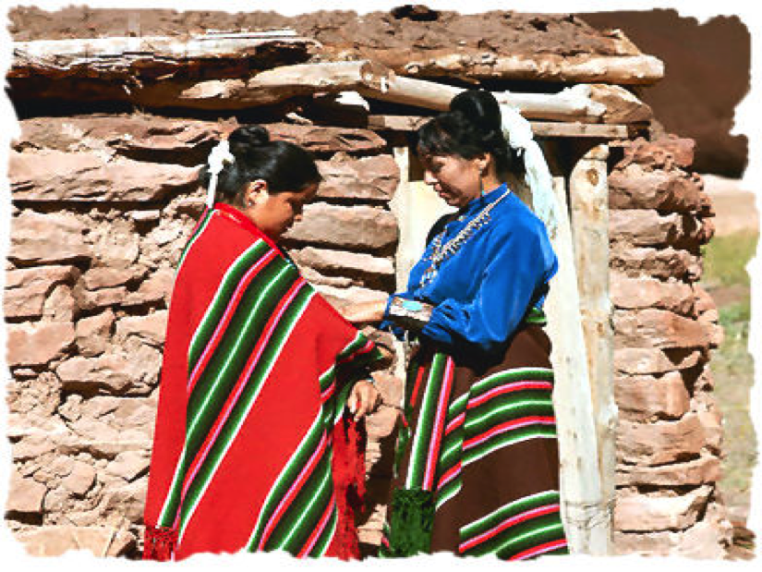
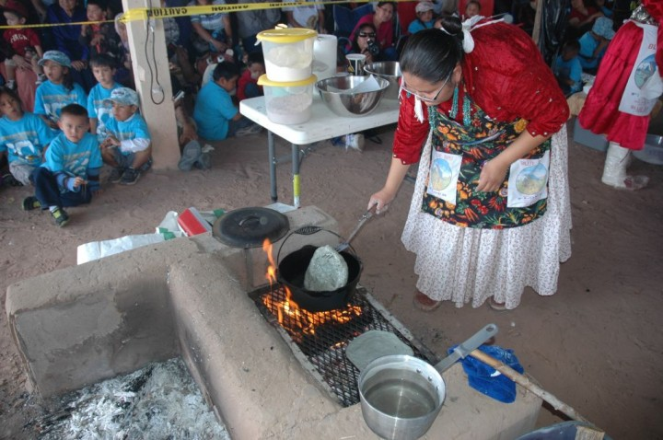
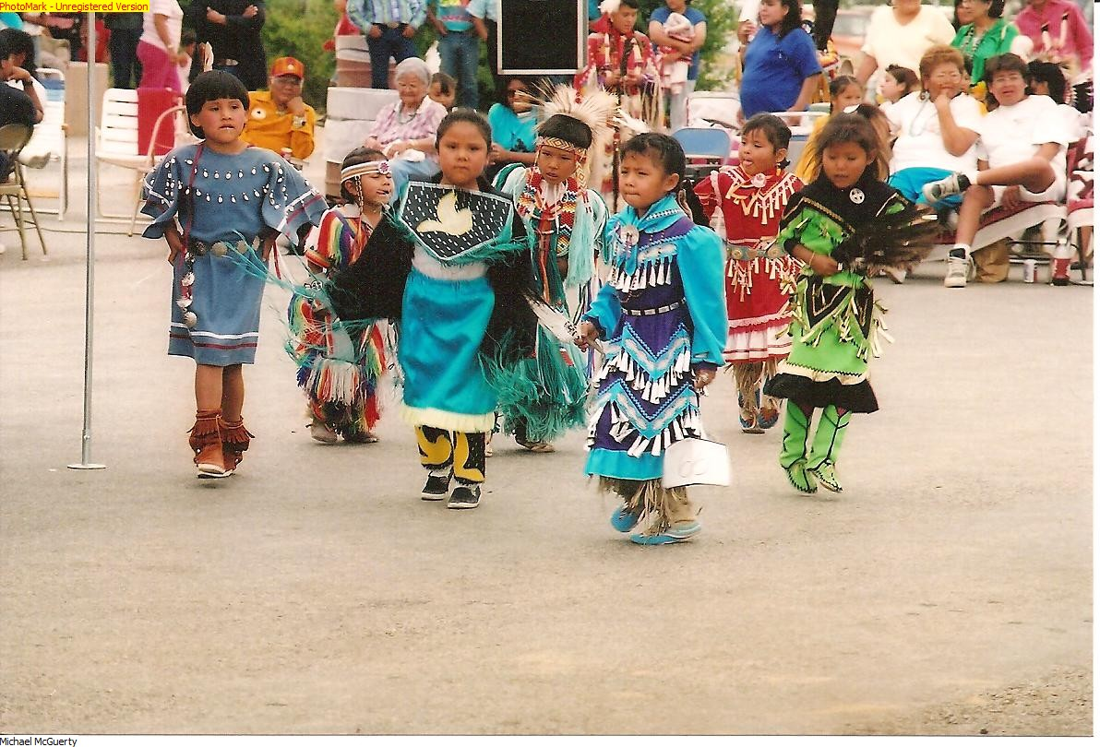

Slide 4
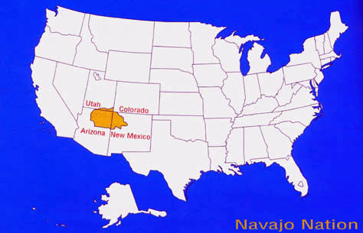
What is interactional competence?
An exchange in a kindergarten classroom on the Navajo Reservation.
Notes:
What is interactional competence? The term has been used by different scholars with different shaded of meaning in several different areas of second language learning, teaching, and testing. In the pages that follow, I will review some uses of the terms, but let’s begin with an example of cross-cultural communication that brings into relief the fact that command of language forms is not enough to ensure successful communication. In her book on the ethnography of communication, Saville-Troike (1989) reported the following exchange in a kindergarten classroom on the Navajo Reservation

Slide 6
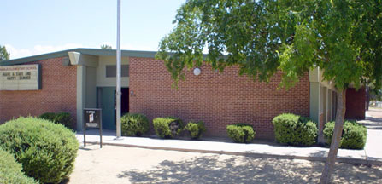
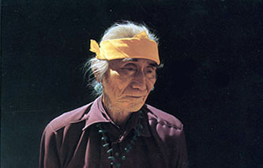
What is interactional competence?
Notes:
A Navajo man opened the door to the classroom and stood silently, looking at the floor. The Anglo-American teacher said ‘Good morning’ and waited expectantly, but the man did not respond. The teacher then said ‘My name is Mrs. Jones’, and again waited for a response. There was none.
In the meantime, a child in the room put away his crayons and got his coat from the rack. The teacher, noting this, said to the man, ‘Oh, are you taking Billy now?’ He said, ‘Yes.’
The teacher continued to talk to the man while Billy got ready to leave, saying ‘Billy is such a good boy’, ‘I’m so happy to have him in class’, etc.
Billy walked towards the man (his father), stopping to turn around and wave at the teacher on his way out and saying, ‘Bye-bye.’ The teacher responded, ‘Bye-bye.’ The man remained silent as he left. (pp. 131-132)

Slide 7
What is interactional competence?
A Navajo man opened the door to the classroom and stood silently, looking at the floor. The Anglo-American teacher said ‘Good morning’ and waited expectantly, but the man did not respond. The teacher then said ‘My name is Mrs. Jones’, and again waited for a response. There was none.
Notes:
Saville-Troike explained the interaction as one in which two of the three parties were interpreting the conversational exchange in different ways. From a Navajo perspective, the Navajo man’s silence is appropriate and respectful; his silence after the Anglo-American teacher’s greeting is also a polite response to her greeting and, if he had identified himself by name, the man would have broken a traditional taboo that prohibits Navajos from saying their own name.
The Anglo-American teacher follows her own expectations that her greeting would be returned and that the unknown man would identify himself.

Slide 8
What is interactional competence?
In the meantime, a child in the room put away his crayons and got his coat from the rack. The teacher, noting this, said to the man, ‘Oh, are you taking Billy now?’ He said, ‘Yes.’

Slide 9
What is interactional competence?
The teacher continued to talk to the man while Billy got ready to leave, saying ‘Billy is such a good boy’, ‘I’m so happy to have him in class’, etc.

Slide 10
What is interactional competence?
Billy walked towards the man (his father), stopping to turn around and wave at the teacher on his way out and saying, ‘Bye-bye.’ The teacher responded, ‘Bye-bye.’ The man remained silent as he left.
Notes:
Billy, who is more used to Anglo ways than his father, displayed interactional competence by taking his leave of the teacher in the way she expected while his father remained silent.
In the interaction described by Saville-Troike, for example, IC can be seen in the identities that Billy, his father, and the teacher attempt to establish through their interaction. For instance, in describing the Navajo man’s reluctance to state his name, it is not enough to say that this is simply a Navajo custom, but we must understand the wider context of the role of personal names in Navajo life, the contexts in which personal names are spoken, and the occasions on which practices of naming are transgressed. The same goes for understanding the Anglo-American teacher’s naming action: “My name is Mrs. Jones.” How does the teacher’s naming herself in this way construct her identity? What are the values associated with overtly naming oneself in Anglo-American culture? What are the meanings that the teacher creates by naming herself as “Mrs. Jones” rather than “Ms. Jones”, or “Sally Jones”, or simply “Sally”? And is naming oneself what Agar (1980) called a “rich point”—a departure from our expectations that signals a difference between Anglo-American and Navajo culture and gives direction to subsequent learning?

Slide 11
What is ‘Competence’?
What is Interactional Competence?

Slide 12
What is ‘competence’?
Noam Chomsky distinguished between a speaker’s knowledge of language in the abstract (competence) and the way in which that knowledge is realized in the production and interpretation of actual utterances (performance).
Notes:
In linguistic theory, the term competence has been taken to mean an individual’s knowledge underlying the production and interpretation of well-formed sentences in a language. The term was first used in this sense by Chomsky (1965), who used it to distinguish between a speaker’s knowledge of language in the abstract (competence) and the way in which that knowledge is realized in the production and interpretation of actual utterances (performance).

Slide 13
What is ‘competence’?
Dell Hymes rejected Chomsky’s dichotomy between competence and performance. He argued that using language in social situations required as much knowledge and skill as knowledge of language as an idealized system: “There are rules of use without which the rules of grammar are useless.”
Notes:
Chomsky’s idea of competence as knowledge of language apart from its use was criticized by Hymes (1972), who countered that not only does competence refer to the individual’s knowledge of the forms and structures of language, but competence also extends to how the individual uses language in actual social situations. In effect, Hymes rejected Chomsky’s dichotomy between competence and performance and argued that using language in social situations required as much knowledge and skill as knowledge of language as an idealized system—in Hymes’s words, “There are rules of use without which the rules of grammar are useless” (p. 278). Hymes then went on to specify the knowledge that speakers must have of at least four ways in which language is used in social situations: what is possible to do with language, what is feasible, what is appropriate, and what is actually done. This combination of ability and knowledge Hymes called communicative competence, which many people contrasted with Chomsky’s theory, and the latter came to be known as linguistic competence.

Slide 14
What is ‘competence’?
In an individual’s communicative competence, Michael Canale and Merrill Swain included …
Linguistic competence
Discourse competence
Pragmatic competence
Strategic competence
Notes:
Hymes’s ideas were the basis for an applied linguistic theory of communicative competence put forward by Canale and Swain (1980) and for tests of communicative language ability theorized by Bachman (1990). These scholars tried to relate linguistic acts in social situations to an individual’s underlying knowledge, and their views became very influential in second language teaching and testing. In both applied linguistic theory and language assessment, competence was recognized as a characteristic of a single individual. An individual’s communicative competence was a complex construct composed of several component parts and it was something that differentiated one individual from others.

Slide 15
What is interactional Competence?
What is Interactional Competence?

Slide 16
What is interactional competence?
Seven resources that participants bring to interaction
Participation framework
Register
Modes of meaning
Speech acts
Turn-taking
Repair
Boundaries
Notes:
Interactional competence builds on the theories of competence that preceded it, but it is a very different notion from communicative competence and communicative language ability. He and Young (1998) wrote of two differences between IC and communicative competence. In one sense, IC simply adds further components to the four components of communicative competence. These were sketched by He and Young as linguistic and pragmatic resources that include, among others: “a knowledge of rhetorical scripts, a knowledge of certain lexis and syntactic patterns specific to the practice, a knowledge of how turns are managed, a knowledge of topical organization, and a knowledge of the means for signaling boundaries between practices and transitions within the practice itself” (p. 6). Young (2008, p. 71) extended the list and wrote that IC includes the following seven resources that participants bring to interaction:
Identity resources
Participation framework
Linguistic resources
Register
Modes of meaning
Interactional resources
Speech acts
Turn-taking
Repair
Boundaries

Slide 17
Participation framework
The identities of all participants in an interaction, present or not, official or unofficial, ratified or unratified, and their footing or identities in the interaction

Slide 18
What is interactional competence?
Seven resources that participants bring to interaction
Participation framework
Register
Modes of meaning
Speech acts
Turn-taking
Repair
Boundaries
Notes:
Interactional competence builds on the theories of competence that preceded it, but it is a very different notion from communicative competence and communicative language ability. He and Young (1998) wrote of two differences between IC and communicative competence. In one sense, IC simply adds further components to the four components of communicative competence. These were sketched by He and Young as linguistic and pragmatic resources that include, among others: “a knowledge of rhetorical scripts, a knowledge of certain lexis and syntactic patterns specific to the practice, a knowledge of how turns are managed, a knowledge of topical organization, and a knowledge of the means for signaling boundaries between practices and transitions within the practice itself” (p. 6). Young (2008, p. 71) extended the list and wrote that IC includes the following seven resources that participants bring to interaction:
Identity resources
Participation framework
Linguistic resources
Register
Modes of meaning
Interactional resources
Speech acts
Turn-taking
Repair
Boundaries

Slide 19
Register
The features of pronunciation, vocabulary, and grammar that typify a practice

Slide 20
Modes of meaning
The ways in which participants construct interpersonal, experiential, and textual meanings in a practice

Slide 21
What is interactional competence?
Seven resources that participants bring to interaction
Participation framework
Register
Modes of meaning
Speech acts
Turn-taking
Repair
Boundaries
Notes:
Interactional competence builds on the theories of competence that preceded it, but it is a very different notion from communicative competence and communicative language ability. He and Young (1998) wrote of two differences between IC and communicative competence. In one sense, IC simply adds further components to the four components of communicative competence. These were sketched by He and Young as linguistic and pragmatic resources that include, among others: “a knowledge of rhetorical scripts, a knowledge of certain lexis and syntactic patterns specific to the practice, a knowledge of how turns are managed, a knowledge of topical organization, and a knowledge of the means for signaling boundaries between practices and transitions within the practice itself” (p. 6). Young (2008, p. 71) extended the list and wrote that IC includes the following seven resources that participants bring to interaction:
Identity resources
Participation framework
Linguistic resources
Register
Modes of meaning
Interactional resources
Speech acts
Turn-taking
Repair
Boundaries

Slide 22
Speech acts
The selection of acts in a practice and their sequential organization

Slide 23
Turn-taking
How participants select the next speaker and how participants know when to end one turn and when to begin the next

Slide 24
Repair
The ways in which participants respond to interactional trouble in a given practice

Slide 25
Boundaries
The opening and closing acts of a practice that serve to distinguish a given practice from adjacent talk

Slide 26
What is interactional competence?
Seven resources that participants bring to interaction
Participation framework
Register
Modes of meaning
Speech acts
Turn-taking
Repair
Boundaries
Notes:
Interactional competence builds on the theories of competence that preceded it, but it is a very different notion from communicative competence and communicative language ability. He and Young (1998) wrote of two differences between IC and communicative competence. In one sense, IC simply adds further components to the four components of communicative competence. These were sketched by He and Young as linguistic and pragmatic resources that include, among others: “a knowledge of rhetorical scripts, a knowledge of certain lexis and syntactic patterns specific to the practice, a knowledge of how turns are managed, a knowledge of topical organization, and a knowledge of the means for signaling boundaries between practices and transitions within the practice itself” (p. 6). Young (2008, p. 71) extended the list and wrote that IC includes the following seven resources that participants bring to interaction:
Identity resources
Participation framework
Linguistic resources
Register
Modes of meaning
Interactional resources
Speech acts
Turn-taking
Repair
Boundaries

Slide 27
Intersubjectivity
What is Interactional Competence?
Notes:
IC involves knowledge and employment of these resources in social contexts. However, the fundamental difference between communicative competence and IC is that an individual’s knowledge and employment of these resources is contingent on what other participants do; that is, IC is distributed across participants and varies in different interactional practices. And the most fundamental difference between interactional and communicative competence is that IC is not what a person knows, it is what a person does together with others.

Slide 28
Intersubjectivity
Claire Kramsch recognized that interactional competence presupposes “a shared internal context or ‘sphere of inter-subjectivity’” and this view is what most clearly distinguishes IC from previous theories of competence.
Notes:
Kramsch (1986) recognized that IC presupposes “a shared internal context or ‘sphere of inter-subjectivity’” and this view is what most clearly distinguishes IC from previous theories of competence. What, then, is intersubjectivity? Developed originally as a philosophical theory in the phenomenology of Husserl (Beyer, 2007), intersubjectivity is the conscious attribution of intentional acts to others and involves putting oneself in the shoes of an interlocutor. Intersubjectivity was first inferred empirically from studies of infant development by Trevarthen (1977, 1979). In studies of interaction between preverbal infants and their mothers, Trevarthen noticed that at around two months of age, infants produced actions of body, hands, and face that were associated with the vocalizations of the mother. It seemed that, although each mother-infant pair was developing a different style of mutual activity, a general pattern of development in social behavior was common to all. Trevarthen (1977) concluded:
I believe a correct description of this behaviour, to capture its full complexity, must be in terms of mutual intentionality and sharing of mental state. Either partner may initiate a ‘display’ or ‘act of expression’ and both act to sustain a sharing and exchange of initiatives. Both partners express complex purposive impulses in a form that is infectious for the other.” (p. 241)

Slide 29
Intersubjectivity
Intersubjectivity in communication requires that
The receiver should come to attend to the situation as intended by the sender.
The sender should know that the receiver is so doing.
The receiver should know that the sender knows that this is the case.
Notes:
Intersubjectivity is explained by Wells (1981) as follows:
Linguistic interaction is a collaborative activity, and this applies just as much to the production and interpretation of individual utterances as it does to longer stretches of discourse. Any act of linguistic communication involves the establishment of a triangular relationship between the sender, the receiver, and the context of situation. The sender intends that, as a result of his communication, the receiver should come to attend to the same situation as himself and construe it in the same way. For the communication to be successful, therefore, it is necessary (a) that the receiver should come to attend to the situation as intended by the sender; (b) that the sender should know that the receiver is so doing; and (c) that the receiver should know that the sender knows that this is the case. That is to say they need to establish intersubjectivity about the situation to which the communication refers. (pp. 46-47, emphasis in the original)

Slide 30
Intersubjectivity
Notes:
One example of the coordination of actions that led Trevarthen to infer intersubjectivity is when the child’s eyes follow the direction of the mother’s gaze or her act of pointing. Another example is when, in ritualized games of routine, the mother pauses before an expected action and the infant performs that action, a projection of the mother’s action which underlies the development of turn-taking in conversation.

Slide 31
The development of interactional Competence
What is Interactional Competence?
Notes:
In 1999, as notions of IC were still being developed, Young wrote, “At this point … no empirical studies have been carried out to test the claims [of interactional competence]. We have, as yet, very few detailed descriptions of the configuration of interactional resources that constitute the interactional architecture of a given practice. […] And we await descriptive and pedagogical studies of how novices become expert participants and the degree to which interactional competence in a given practice can be generalized to other practices” (pp. 119-120). A decade later the situation has improved, with a number of published studies describing the development of IC in instructional, study-abroad, and professional contexts. In all these studies, IC has been described in spoken interaction and their longitudinal focus has been on the developing pragmatic relationship between learners’ employment of interactional and linguistic resources and social context. Several studies have focused on the way that IC is co-constructed by all participants in dyadic or multi-party interaction, but only one researcher has investigated the social, institutional, political, and historical circumstances that extend beyond the horizon of particular interactions. These studies are summarized below.

Slide 32
Studies of the development of interactional competence through …
Co-construction of a repetitive practice
Study abroad
Multi-party interaction at school
Co-construction of social identity by novice pharmacists

Slide 33
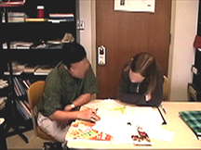
Co-construction of a repetitive practice
Notes:
Young, R. F., & Miller, E. R. (2004). Learning as changing participation: Negotiating discourse roles in the ESL writing conference. The Modern Language Journal, 88(4), 519-535.
explored how IC develops in recurrent dyadic interactions in which one participant is a second language learner and the other participant a native speaker.
The discursive practice that Young and Miller reported they called revision talk, which formed part of writing conferences between a Vietnamese student of ESL and his American tutor. The conferences took place once a week over a period of four weeks. Before each writing conference, the student had written a draft of an essay on a topic assigned by the tutor, and during revision talk the tutor and student identified problem areas in the student’s writing, talked about ways to improve the writing, and revised the essay.
Young and Miller claimed that the student acquired IC in the practice of Revision Talk, which they noted was co-constructed by the tutor:
It appears that the student is the one whose participation is most dramatically transformed, but the instructor is a co-learner, and her participation develops in a way that complements the student’s learning. In fact, the effectiveness of the instructor is precisely in how she manages a division of participation that allows for growth on the part of the student. (p. 533)

Slide 34
Study abroad
Notes:
Dings, A. (2007). Developing interactional competence in a second language: A case study of a Spanish language learner. Ph.D. doctoral dissertation, University of Texas, Austin.
Dings (2007), is the most extensive study to date of the development of IC. Dings reported on six 30-minute conversations in Spanish between Sophie, an American study-abroad student living in Granada, Spain and José, a native speaker of Spanish. The conversations were recorded at the beginning, middle, and end of two semesters of Sophie’s sojourn in Granada.
Dings summarized Sophie’s development of IC as follows:
“Over the course of the year abroad Sophie showed some degree of development in all of the resources analyzed with the exception of topic initial elicitors. By the end of her stay abroad, she showed stronger skills in both speaker selection and alignment activity, and some skill in topic management in terms of topic transition markers.” (p. 207)
In addition, Dings noticed development in ways in which Sophie collaboratively constructed the conversation with José:
“The most noticeable changes seen in co-construction while Sophie was holding the floor were the changing patterns in repair. […] In general terms, José’s role when holding the floor was relatively stable over the course of the year, while Sophie showed a growing involvement in elaborately co-constructing the interaction with José through her skillful deployment of alignment moves.” (p. 215)

Slide 35
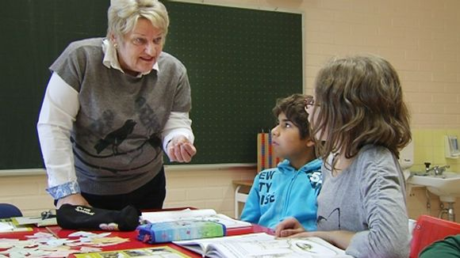
Multi-party interaction at school
Notes:
Cekaite, A. (2007). A child’s development of interactional competence in a Swedish L2 classroom. The Modern Language Journal, 91(1), 45-62.
Cekaite (2007) is a longitudinal study of one 7-year-old immigrant child’s developing IC with her teacher and peers in a Swedish immersion language classroom. The child, Fusi, was a Kurdish girl from Iraq who spoke Kurdish and Arabic but whose Swedish was minimal at the beginning of the study.
Cekaite distinguished three phases in Fusi’s development of IC over the school year.
In the early phase, Fusi was mostly silent and participated only marginally in classroom activities. Her attempts to initiate a topic and to select herself as a conversational participant were nonverbal. Cekaite reported that Fusi “recurrently tried to get the teacher’s and the children’s attention by pretending to run away from the schoolyard or by pretending to cry in the classroom […]. However, her peer group and her teachers rather quickly became bored with her staged escapes” (p. 49).
During the middle phase, Fusi’s contributions were verbal but interactionally inappropriate. Cekaite reported that Fusi “frequently talked loudly, almost screaming, and her contributions were recurrently marked as unmitigated disagreements, which often resulted in conflict with the teachers or with the other children” (p. 50). In response, her teacher either ignored or explicitly disciplined her while her peers continued to self-select in conversations with the teacher. Cekaite commented that such responses to Fusi’s attempts to participate provided her with explicit or implicit socialization to the norms of classroom conversation.
In the final stage of observation, Fusi began to participate as a competent member of the classroom community. Cekaite reported that Fusi “mastered a more elaborate Swedish repertoire and developed interactional skills allowing her to participate in spontaneously evolving whole-group conversational activities, which in turn shaped interactional learning affordances” (p. 58). Her teachers paid attention to her initiatives and engaged in conversational exchanged with her. Thus, through participation in recurrent classroom discursive practices but with little explicit instruction in the norms of interaction, Fusi learned how classroom interaction was designed and how to participate effectively in it.

Slide 36
Co-construction of social identity by novice pharmacists
Notes:
Nguyen, H. t. (2006). Constructing ‘expertness’: A novice pharmacist's development of interactional competence in patient consultations. Communication and Medication, 3(2), 147-160.
Nguyen (2006) compared two patient consultations performed by Jim, an advanced student of pharmacy employed as an intern at a community pharmacy. Over a period of three weeks, Jim demonstrated development of his participation status in patient consultations from novice expert to experienced expert.
Unlike the novice expert, the experienced expert is someone who not only has access to professional knowledge, but also ‘no longer relies on analytic principles (rules, guidelines, maxims)’, and ‘has an intuitive grasp of each situation and zeroes in on the accurate region of the problem without wasteful consideration of a large range of alternative diagnoses and solutions.’
In an early patient consultation, Jim displayed his expert knowledge about administration and side effects of a medication using technical vocabulary despite the patient’s apparent lack of interest; in doing so, Jim constructed an identity for himself that Nguyen called novice expert.
In contrast, after working in the community pharmacy for three weeks and having participated in many patient consultations, Jim displayed an alignment with the patient’s stance that was absent three weeks earlier. Nguyen went on to show how during his internship Jim developed other skills in patient consultations, including his responses to patients’ challenges, the development of a shared perspective with his patients toward medication and toward the technical language provided in the patient information slips that are provided with every prescription. As his participation status as novice expert developed, Jim was able to utilize interactional and verbal resources more skillfully, both in displaying his expertise and in maintaining a stance of alignment with his patients—both of which are, according to Nguyen, important attributes of an experienced expert.

Slide 37
Studies of the development of interactional competence through
Co-construction of a repetitive practice
Study abroad
Multi-party interaction at school
Co-construction of social identity by novice pharmacists

Slide 38
Teaching interactional Competence
Interactional competence in local and global ELT
Notes:
The authors of these studies have provided detailed descriptions of learners’ development of interactional competence, but they have provided little evidence of how the changes in IC occurred. In other words, no study so far has been designed to address the question of how to teach interactional competence. Some scholars have, however, theorized how IC may be taught, and their work is briefly reviewed in the next section.

Slide 39
Teaching interactional competence
By standing outside of interactive practices that are of significance to the group(s) whose language is being learned, and analyzing the conventional ways that verbal resources get used, the movement that occurs between their conventional meanings and their individual uses, and the consequences that are engendered by the various uses, we can develop a far greater understanding both of ourselves and of those in whose practices we aspire to become participants.
Joan Kelly Hall
Notes:
Hall (1999) also maintained that second language learners can attain IC in part by the systematic study of discursive practices outside the classroom, a study that she termed “the prosaics of interaction.”
The process of teaching would then involve two moments. In the first, learners are guided through conscious, systematic study of the practice, in which they mindfully abstract, reflect upon, and speculate about the sociocultural context of the practice and the verbal, interactional, and nonverbal resources that participants employ in the practice. In the second moment, learners are guided through participation in the practice by more experienced participants. These two pedagogical moments, Hall argues, facilitate the development of interactional competence in the second language.

Slide 40
Teaching interactional competence
For developing interactional competence, spending time in the target community is no panacea, length of residence is not a reliable predictor, and L2 classrooms can be a productive social context. In other words, exposure alone to discursive practice in a second language community is not an efficient instructional strategy, no matter how long or how intense the exposure.
Gabriele Kasper
Kenneth Rose
Notes:
In study abroad contexts, however, Dings (2007) both reported that learners sojourning in the community where the second language is used in everyday interactions have in fact developed aspects of interactional competence, specifically the ability to take a point of view or stance of an interlocutor. If this is so, is it not enough to learn IC simply by extended interaction in the second language community? Relevant research on the effect of study abroad on the development of pragmatic competence was reviewed by Kasper and Rose (2002), who concluded that “For developing pragmatic ability, spending time in the target community is no panacea, length of residence is not a reliable predictor, and L2 classrooms can be a productive social context” (p. 230). In other words, exposure alone to discursive practice in a second language community is not an efficient instructional strategy, no matter how long or how intense the exposure.

Slide 41
Teaching interactional competence
Students acquire a general method to construct a concrete orientation basis to solve any specific problem in a given subject domain. Such a general method involves a theoretical analysis of objects, phenomena, or events in various subject domains. The main feature of the analysis is that it reveals the ‘genesis’ and the general structure of objects or phenomena (the general make-up of things). In such analysis, students learn to distinguish essential characteristics of different objects and phenomena, to form theoretical concepts on this basis, and use them as cognitive tools in further problem solving.
Гальперин П.Я.
Notes:
Young (2009) extended Kasper & Rose’s conclusion about the development of pragmatic competence to interactional competence and argued that there is considerable support for a pedagogy of conscious and systematic study of interaction in the work of the Soviet psychologist Gal’perin and his theory of systemic–theoretical instruction also known as concept-based instruction. Instruction, in Gal’perin’s view, is the provision of efficient cultural psychological tools to learners so that they may solve problems in a specific domain. Comparing the kinds of cultural mediation available to learners in different types of instruction, Gal’perin concluded that the most efficient tool for learners is the provision of a general procedure that learners can use to solve any specific problem in a given instructional domain. For Gal’perin, the initial step in the procedure is construction of a “schema for a complete orienting basis for an action” (Gal’perin, 1974b, p. 70), which is in effect a theory of the domain of instruction. The new practice to be learned is first brought to the learner’s attention, not in the small stages that characterize behaviorist instruction, but as a meaningful whole from the very beginning of instruction.

Slide 42
What is interactional Competence?
What is Interactional Competence?

Slide 43
What is interactional competence?
Notes:
IC can be observed (or its absence noted) in recurring episodes of social interaction in context, episodes that are of social and cultural significance to a community of speakers. In Saville-Troike’s example, greeting, leave-taking, and picking up a child from school are all discursive practices because they are episodes of spoken interaction that occur regularly and have significance in a community of speakers. Because discursive practices recur, participants have expectations about what happens in a practice and what linguistic and nonverbal resources people employ in constructing the practice.
A second aspect of IC involves participants recognizing and responding to expectations of what to say and how to say it. These expectations lead participants to interpret forms of talk in a given practice with conventional meanings and may lead to misinterpretations when forms of talk do not meet their expectations. The encounter undoubtedly reinforced the teacher’s stereotype that Navajo’s are ‘impolite’ and ‘unresponsive’, and the man’s stereotype that Anglo-Americans are ‘impolite’ and ‘talk too much’.
The third aspect of IC is not the ability of a single individual to employ those resources in any and every social interaction; rather, IC is how those resources are employed mutually and reciprocally by all participants in a particular discursive practice. This means that IC is not the knowledge or the possession of an individual person, but is co-constructed by all participants in a discursive practice, and IC varies with the practice and with the participants.
The relationship between context and practice is a complex one, but it is not arbitrary. IC can be seen in the identities that Billy, his father, and the teacher attempt to establish through their interaction. For instance, in describing the Navajo man’s reluctance to state his name, it is not enough to say that this is simply a Navajo custom, but we must understand the wider context of the role of personal names in Navajo life, the contexts in which personal names are spoken, and the occasions on which practices of naming are transgressed. The same goes for understanding the Anglo-American teacher’s naming action: “My name is Mrs. Jones.” How does the teacher’s naming herself in this way construct her identity? What are the values associated with overtly naming oneself in Anglo-American culture? What are the meanings that the teacher creates by naming herself as “Mrs. Jones” rather than “Ms. Jones”, or “Sally Jones”, or simply “Sally”? And is naming oneself what Agar (1980) called a “rich point”—a departure from our expectations that signals a difference between Anglo-American and Navajo culture and gives direction to subsequent learning?

Slide 44
What is interactional competence?
Interactional competence has been studied in spoken interaction, although nonverbal aspects of spoken interaction are seen as important.
The pragmatics of interaction—the relationships between the forms of talk chosen by participants and the social contexts in which they are used—are fundamental to interactional competence.
Interactional competence is the construction of a shared mental context through the collaboration of all interactional partners.
The context of an interaction includes the social, institutional, political, and historical circumstances that extend beyond the horizon of a single interaction.
Notes:
To summarize, the notion of IC has been used by different scholars in different ways, of which four aspects are foundational. First, discussions of IC have focused largely on spoken interaction, although nonverbal aspects of spoken interaction have often been seen as important. Second, in many discussions, the pragmatics of interaction—the relationships between the forms of talk chosen by participants and the social contexts in which they are used—has been considered as fundamental to IC. Third, IC is not to be described in the knowledge and actions of an individual participant in an interaction; instead, IC is the construction of a shared mental context through the collaboration of all interactional partners. Finally, the context of an interaction is not limited to the sequence of talk that occurs at a specific time and place; understanding IC thus requires an investigation of social, institutional, political, and historical circumstances that extend beyond the horizon of a single interaction.

Slide 45
Notes:
Khob khun krub

