Slide 1
Researching and teaching L2 interactional competencies
Bridging frameworks:
Thorsten Huth, Ph.D.
German & Linguistics
The University of Tennessee, Knoxville

Slide 2
Connections
Understanding language
Understanding language as action (& interaction)
Understanding language learning
Understanding language teaching

Slide 3
Disciplinary grounding
Understanding language
Linguistics
Understanding language as action (& interaction)
Conversation Analysis (CA)
Understanding language learning
Second Language Acquisition (SLA)
Understanding language teaching
Pedagogy

Slide 4
Language: Classic taxonomy
Sounds (Phonology, Phonetics)
Words & word formation (Lexis, Morphology)
Sentences (Syntax)
Meaning: Semantics
Meaning: Pragmatics

Slide 5
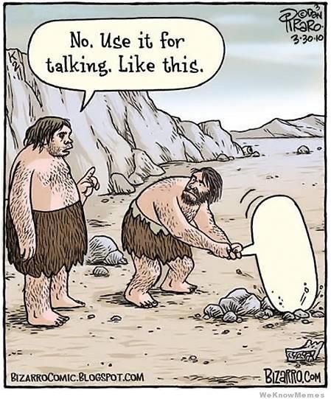

Slide 6
Language as action: Pragmatics
The study of language in (social, cultural) context
Language use (rather than iLanguage)
Language as action, achievement
What actions do we perform when we make an utterance?
When I say something - what does that do?

Slide 7
Prominent frameworks
Politeness theory (Brown & Levinson, 1987): face-threatening acts, positive/negative politeness
Gricean maxims (Grice, 1975): quality, quantity, relevance, manner
Speech act theory (Austin, 1962; Searle 1969)
Pragmatics (Leech, 1983, Levinson, 1983, Mey, 2001)

Slide 8
Assumptions
Language as object of study = 1) the well formed, 2) complete, 3) written 4) sentence isolated from context.
All action-relevant cues can be found on the sentence level (i.e. in words and morpho-syntactic principles)
Intention behind a message can be gauged from the outset
Content of a message can be gauged from the outset
Effect of a message can be gauged from the outset
Native speakers have direct & reliable insight into how their language works on the action level

Slide 9
Thank you - I
A: Here’s your coffee!
B: Thank you!

Slide 10
Thank you - II
A: (opens door for B)
B: Thank you!

Slide 11
Thank you - III
A: Thank you!
B: You’re welcome.

Slide 12
Thank you - IV
A: I love you.
B: Thank you!

Slide 13
Thankful insights
What we say always also does something
What is done depends on interactional context - specifically, placement in the back and forth of talk
Placement matters: What did just happen, what happens now, what is to happen next (“conditional relevance”)
With each turn we take, context & meaning are renewed
With each turn we take, the forward trajectory of what is relevantly and fittingly to “come next” may change

Slide 14
Language as action
(A and B meet for the first time. A notices B and starts talking.)
A: Good morning!
B: What do you mean? Do you mean to wish me a good morning or do you mean it is a good morning whether I want it or not? Or perhaps you mean to say that you feel good on this particular morning. Or are you simply stating that this is a morning to be good on?

Slide 15
On intentionality & understanding
Action can be multifaceted
What we say in a given sequential position might mean (i.e. do) a number of things
Action can be ambiguous
We actively, consciously ascribe action to that which was said in a given moment
“The big question is not whether actors understand each other or not. The fact is they do understand each other, they will understand each other, but the catch is that they will understand each other regardless of how they would be understood.” (Garfinkel, 1952:367)

Slide 16
Interaction: Beyond the sentence
Streeck (1980): Verticality in talk: “Speech acts” may span multiple turns in interaction
Golato (2003): Perception vs. reality; what people think they do in interaction and what they actually do may be (and often is) quite different

Slide 17
Conversation Analysis & interaction
Conversation is incrementally built from UTTERANCES
Utterances follow one another as TURNS
Some turns are TYPED
Some typed turns are forming PAIRS
(i.e. question-answer; invitation-acceptance/rejection; compliment-response)
Pairs have FIRST PARTS and SECOND PARTS
Typed turns & pairs may occur as regular SEQUENCES
PREFERENCE ORGANIZATION: Some second pair parts are preferred over others

Slide 18
What is interactional competence?
General:
the ability to make relevant and fitting contributions to an ongoing conversation in an orderly way
Specific:
the ability to anticipate, interpret, and produce relevant next turns in specific sequential contexts

Slide 19
L2 learning: Transfer on all levels
Native speaker “blindness”; L2 learner “blindness”
L2 learners learn: sounds, words, grammar
L2 learners transfer L1 interaction patterns when using L2 to fulfill their social and interactional needs (pragmatic transfer, see Kasper 1992)
Transfer = major mechanism underlying difficulties in cross-cultural communication
—>as you collect NS-L2 learner data, make sure you know what the nature of your recordings are

Slide 20
Researching (inter-)action
Record naturally occurring interaction
Transcribe interaction in great detail (“high granularity”)
Demonstrate what interactants are doing (i.e. analyze action) by working out how & as what interactants are understanding their co-participant’s action to be in situ
—> “next turn proof procedure”

Slide 21
Language learning & teaching
Can we teach learning targets that are situated beyond the sentence level?
Can the ability to anticipate, interpret, and produce relevant next turns be taught and learned?
Can turns, sequences of turns, paired action, preference structure be taught and learned in institutional settings?

Slide 22
Basic SLA inquiry
Research learnability/teachability of interactional mechanisms
Procedure:
find CA-studies on German & English
prepare teaching units, do in class
pre-test (role play), teach unit in class, post-test (role play), compare verbal behavior

Slide 23
Specific research targets
Telephone opening sequences (Huth & Taleghani-Nikazm, 2006)
Compliment-responses (Huth, 2006)
Requests (Taleghani-Nikazm, 2010)

Slide 24
Results
L2 interaction patterns are learnable on the beginner level (second semester!) to the point of de facto use in real-time-talk in the L2
L2 interaction data illustrate that L2 learners are able to a) anticipate, b) interpret, and c) produce relevant next turns in ways specific to the L2 structures they learned weeks after the teaching unit
L2 learner perception data (self-reports) showed that the teaching of interaction patterns
heightened L2 learners’ meta-linguistic awareness
heightened L2 learners’ cultural reasoning skills

Slide 25
Implications
There is no reason to avoid teaching L2 interaction patterns as a learning target
There are good reasons to start teaching interaction patterns from the very beginning
Pedagogical models to teach L2 interaction patterns are available
Challenge: finding reliable, empirical studies to support this effort

Slide 26
Outlook: Current, future challenges
Prepare and make accessible concrete teaching materials (Betz & Huth, 2014), including assessment
Create teaching materials including audio & video
Make it count: Integrate materials systematically into elementary & intermediate language class sequences
Educate the field: Make interactional competencies an accepted learning target in the profession, train colleagues
Educate future language teachers: Train future professionals

