Slide 1
Rethinking Strategies in Interaction: Action and Resources
September 15th, 2016
Rue Burch
Rice University

Slide 2
Todays Plan
Some disclaimers about me
Discussion:
Rethinking communication strategies in light of Levinson’s “Interaction Engine”
Data: “Long name”
Discussion: Implications for…
IC development
Interaction in and outside of the class
Teaching and Assessment

Slide 3
Goals
To reconsider the notion of communication strategy in relation to
interactional competence
To draw attention to how resources can be assembled, recycled
and built upon
3) To identify the relevance of this topic for L2 teaching in terms of…
… adding to learners’ “tool kits”
… teachability
… assessability
I’m posing these as a puzzle. I have opinions, but may not have “answers”
(at least none that are any more valid than yours)

Slide 4
Disclaimers
My own interests, agendas, biases…
CA for SLA
Communication Strategies
Motivation, WTC, Individual Differences
TBLT
Embodiment, Use of Materials, Distributed Cognition
Exploring connections with Anthropology, Sociology, Psychology etc.
Topics of ‘traditional’
interest to SLA
researchers

Slide 5
Communication Strategies (?) ¯\_(ツ)_/¯
Your views…
What is a communication strategy? What makes a strategy a strategy?
Good for learners to employ, or bad?
Teachable? If so, should we teach them?
Discuss in small groups

Slide 6
Communication Strategies (?) - CERF

Slide 7
Communication Strategies (?) - CERF
But why consider these
strategies? They are simply
what we do when we
interact.
Will take up on the next
page

Slide 8
Communication Strategies (?) ¯\_(ツ)_/¯
‘Traditional’ View
(Potentially) Conscious
Planned, Goal directed
Compensatory
Canale & Swain (1980); Dörnyei & Scott (1997); Færch & Kasper (1983), Kellerman (1991); Kellerman & Bialystok (1997); Tarone & Yule (1997)
How can we tell?
Does it matter if it is?
Whose goals?
When does the planning happen?
Who judges? (Etic vs Emic)
From an IC perspective,
does it matter if it is?

Slide 9
Communication Strategies (?) ¯\_(ツ)_/¯
Let’s reconsider…
If… the goal of language learning is to be able to interact
and more interaction provides more input (recursively)
and the goal of interaction is intersubjectivity
then… things we consider productive* strategies are simply “methods”
or “resources” for achieving intersubjectivity
which in turn afford more opportunities for input and
negotiation of meaning
* productive as opposed to avoidance (cf. Markee 2011)

Slide 10
A metaphor…
You’re outside of a locked room that you absolutely
must get into. What is the best tool to use?
Of course, a key.
You don’t have one.
Can you get in? How?
These methods may not be clean or efficient,
they may mean you need to apologize or
clean up later…
…but they get you in the room.
All linguistic and communicative resources are tools for an interactional job.
Some work better than others.
The use of one that doesn’t work as well may lead to the opportunity to get one that works better.
This goes for grammar, vocabulary, constructions, pragmatic formulas, discourse connectors,
repair initiations, action formulations, ad infinitum

Slide 11
A case in point…
Levinson’s story about
Kpémuwó
Can anyone refresh us
on the gist?
This is just one bit of evidence
for what Levinson calls “The Interaction Engine”

Slide 12
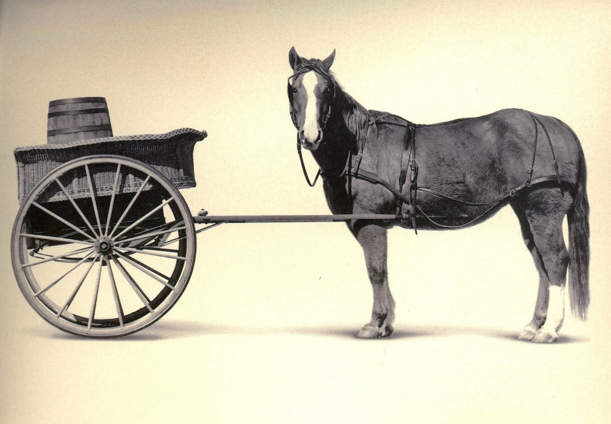
A couple of quotes…
…so much attention has been given to [language]
that we have been damagingly distracted from the
interactional underpinnings that make it possible.
(Levinson, 2006)
Language didn’t make interactional intelligence
possible, it is interactional intelligence that made
language possible as a means of communication.
(Levinson, 1995)

Slide 13
A caveat about the “Interaction Engine”
Not concerned with a
mental “black box”
Also connected to the
purposes of interaction
Varied but systematic,
Not pre-determined, but also not “anything goes”

Slide 14
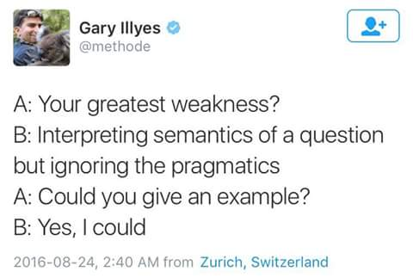
Outputs of The Engine (please help me unpack these)
Responses are to actions or intentions
Theory of Mind
Intention Attribution
Consider how this relates to
second pair parts / responses

Slide 15
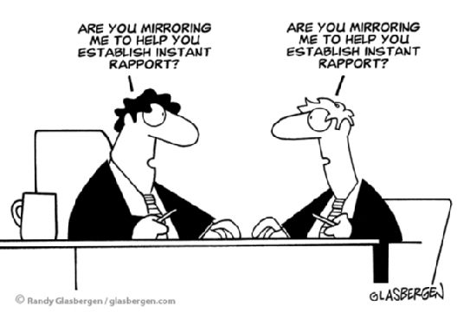
Outputs of The Engine (please help me unpack these)
2) Recipient Design
Mutual Knowledge / Common Ground
Mutual Salience
Reflexive understanding of
self in other’s eyes

Slide 16
Outputs of The Engine (please help me unpack these)
3) Language is only one way of conducting action
‘Nonce signals’
‘Home sign systems’
Embodiment

Slide 17
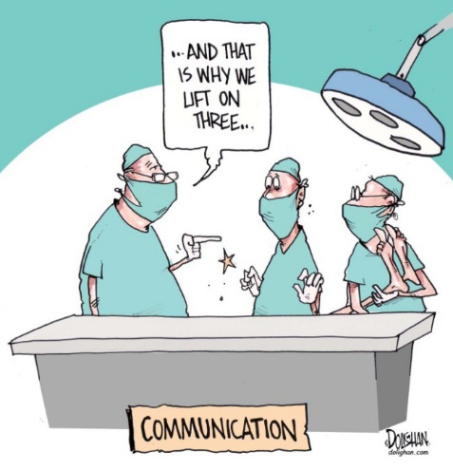
Outputs of The Engine (please help me unpack these)
4) Cooperation
Gricean Maxims
(and implicature)

Slide 18
Outputs of The Engine (please help me unpack these)
5) Action chains and sequences
Expectation/Normativity (not rules!)
Conditional Relevance
A: Are you doing anything tonight?
B: No, why?
A: I was wondering if you’d like to
catch a movie.
B: Sure, what’s on?
What is the activity here? What are the actions?
Breaching Experiments

Slide 19
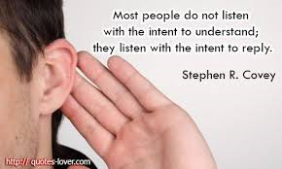
The Engine (please help me unpack these)
6) Reciprocity of roles, Turn-taking
Discourse identities (Zimmerman, 1998)
As well meaning as this is, what‘s the problem with it?

Slide 20
Outputs of The Engine (please help me unpack these)
7) Participation structure/framework (Goffman, 1981)
Footing / Recipient roles
Ratified participation
I personally have a hard
time understanding language
on the TV, even when I understand
it in face to face talk. Why?

Slide 21
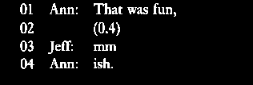
Outputs of The Engine (please help me unpack these)
8) Normatively close timing
Immediate responses → Implications of delay
How does Ann interpret
Jeff’s delay?
Sidnell (2010) p. 2

Slide 22
Outputs of The Engine (please help me unpack these)
9) Multimodal signal streams
Embodiment, gesture, facial expressions
An assessment?
A repair initiator?

Slide 23
Outputs of The Engine (please help me unpack these)
10) Universals (?!?)
Crosslinguistic similarities regarding many of
these elements
How do you say ‘huh’ in
the languages you know?
This is an example of an
“open class repair initiator

Slide 24
Bricolage
An assemblage of resources
and materials, brought together
for a purpose and fit to the
needs and goals of the current
project.
Random?
Anything Goes?

Slide 25
Communication Strategies (A Slight Return)
Using the term ‘strategy’ as a placeholder…
“Productive” strategies (as opposed to avoidance*, etc.) are aimed at achieving intersubjectivity – the point of interaction.
* Avoidance strategies certainly have an intersubjective function, but they may not fit pedagogical goals
As such, they are inextricably linked to the elements of Levinson’s “Interaction Engine”.
They also exhibit the use of a wide variety of resources and materials (bricolage).
They are cooperative and “keep the channel open”, providing opportunities for further interaction.

Slide 26
The Data
Conversation Table (arranged but not guided)
* “Danny (Taka)” –
L1 Japanese, L2 English,
* “Jon” –
L1 English, L2 Japanese (3rd year),
* First time meeting
* Data from first minute of talk

Slide 27
The Data – Reading the transcription
+ shows onset of embodiment
GZ = gaze
BH = Both Hands (cf RH, LH)
Embodiment
--- embodiment continues
Talk
Gloss
Translation
/ / / rhythmic repetition of movement

Slide 28
The Data - Procedure
Multiple viewings
Ask questions about transcription
2) Individual analysis time (10 minutes)
(Just choose a spot that is interesting to you)
3) Small group discussion
4) Large group discussion

Slide 29
The Data – Questions to focus on
What actions do they accomplish?
What resources do they employ?
In what ways do we see opportunities for pushing competencies or
learning?
For large group: How can this provide a model for what we hope to see
students do? How can we encourage it? What kinds of tasks create
opportunities for it?
5) How do we account for or deal with such ‘strategies’ in assessment?

