Slide 1
Developing Critical Thinking Through sociolinguistic analysis of Authentic data
Meng Yeh Rice University
myeh@rice.edu
CLIC Summer Workshops for L2 Teachers
8/13/2016

Slide 2
Critical Thinking
What is critical thinking?
process of actively and skillfully conceptualizing, applying, analyzing, synthesizing, and/or evaluating information (Scriven and Paul, 1987)
How do we develop critical thinking in a language class?

Slide 3
Sociolinguistic Analysis of Authentic Data
sociolinguistic analysis: examine language uses in social and cultural contexts
not just ‘talk about’ culture
language uses reflecting social and cultural values and norms.
textbook dialogues, insufficient.
naturally occurring conversation
guided inductive approach
Notes:
独立思考，批判思维 （客观、科学的角度）

Slide 4
Lesson Samples
打招呼 (greeting) beginning Level
请求与回绝 (request & refusal) intermediate
老家 (hometown) advanced
Notes:
Raising language awareness, conduct language analysis, cultivate their critical thinking
Communicative goals: proficiency in 4 skills, able to use the language and function in the target-language speaking country

Slide 5
打招呼 (greeting)
Objective: To greet people in various contexts.
Textbook greeting A: 你好。B: 你好。(Ni Hao)
A: 你好吗? B: 我很好，谢谢。

Slide 6
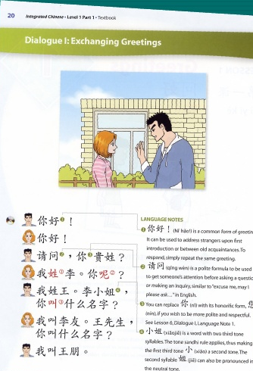
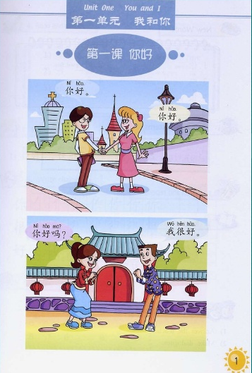
Textbook Greeting
‘Ni hao” is a common form of greeting. It can be used to address strangers upon first introduction or between old acquaintances.
Notes:
Ni hao is a common form of greeting. It can be used to address strangers upon first introduction or between old acquaintances.

Slide 7
The Great Wall 《北京故事》

Slide 8
The Great Wall 《北京故事》
载华 (M): 妳好. (Ni hao ‘hello’)
莉莉 (F): 你好个什么呀? 你又不是美国人，见了生人，还得你好，你好的。。。 “Why are saying Ni Hao to strangers? You aren’t Americans.”

Slide 9
打招呼 (greeting)
学生看到老师时…老师早，老师好 When students greet teacher….Good day, Teacher
老师看到学生时…去上课啊？去哪儿？ When teachers meet student…Going to classes? Where are you going?
中午碰到同事时…吃饭去啊？吃饭没？ When meeting colleagues at noon…Go to eat lunch? Did you eat?
在商场碰到朋友时…哎，买东西啊？ When meeting friends in a shopping meal…coming to shopping?

Slide 10
Listen to the two dialogues
Notes:
2nd, textbook, start 11

Slide 11
First-semester Chinese
Textbook dialogue | Natural conversation
M: 白英爱，九月十二号是星期几？ F: 星期四。 M: 那天是我的生日。 F: 是吗?你今年多大？ M: 十八岁。 F: 我星期四请你吃饭，怎么样？ M: 太好了，谢谢，谢谢。 | A: 欸， 玉芬，下课啦…，你要去哪儿？ B: 嗯，回家去呢… A: 回家啊，哦，你…这个周末做什么啊？ B: 周末啊… A: 嗯。 B: 你知道吗？ A: 嗯。 B: 周末是我生日耶！ A: 生日啊？！真的？ B: 对啊，好高兴喔！ A: 生日快乐啊… B: 喔，谢谢，谢谢… A: 是…是几月几号？ B: 明天不是十一月十一号嘛？你忘了？ A: 就明天，哦… A: 那你…多大啦？ B: 嗯，明天十八，今天还十七。 A: 那…明天我们一块儿吃个饭吧…啊… B: 吃饭啊…

Slide 12
Textbook dialogue | Natural conversation
M: Bai Ying’ai, which day of the week is September 12th? F: It is Thursday. M: That day is my birthday. F: Really? How old are you? M: 18. F: I take you to dinner on Thursday. How is it? M: Wonderful. Thanks, Thanks. | A: Ei, Yufen, Class finish la…, Where are you going? B: Ng, Going home ne. A: Going home a..o.., what are you going to do this weekend? B: Weekend a, A: Ng B: Do you know? A: Ng B: This weekend is my birthday ye. A: Birthday a, Really? B: Yes a… So happy wo! A: Happy Birthday a! B: Wo! Thank you…Thank you. A: Is…is which date? B: It is November 11th tomorrow ma …You forgot? A: IS tomorrow, o…

Slide 13
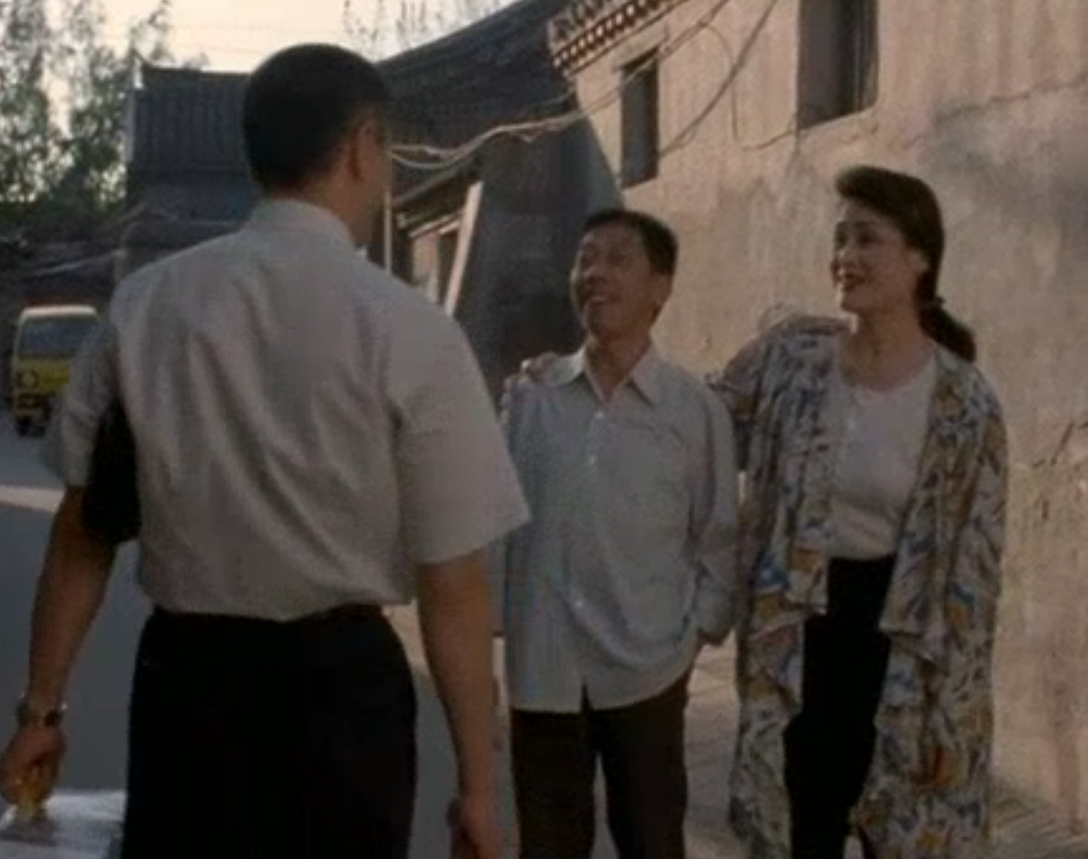
First-semester Chinese
Dialogue A couple greets their neighbor. The couple has not met the neighbor for a while (from the movie “Shower”).
太太: 哟！ (Wife: Yo!)
先生: 回来啦。 (Husband: back home la)
邻居: 哎，出去啊？(Neighbor: ai, going out a?)
先生: 看电影儿。 (Husband: going to a movie)
太太: 回见啊. (Neighbor: see you later a)
邻居: 哎！ (Husband: ai)

Slide 14
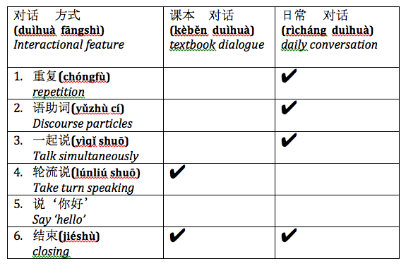
Compare Textbook lessons and Natural Conversation

Slide 15
Request/Refusal scenario
Student A:
It is the final exam week. You try to get your classmate to help you review the math problems. You know that she is quite busy now, but without her help, you definitely will not do well in the test. How do you ask your classmate to help you?
Student B
It is the final exam week. Your classmate wants you to help her review the math problems. You are busy preparing for your own finals, and really do not have time. How do you reply to her request?

Slide 16
Dialogue comparison
What are the differences between students’ dialogue and native speakers’?
What are the request/refusal strategies used by the native speakers?

Slide 17
Dialogue comparison
Request acts
Desperate feeling (I am dying…I beg you…)
Praising (You are so good at math…)
Make it less imposing (just half an hour…)
Compensation (take you out for dinner…)
Refusal acts (Not to say NO directly)
Provide reasons (I have 2 tests…)
Soften the refusal, provide help (My roommate…)
Give assurance (I am sure she will help you.)

Slide 18
Hometown
Rice Summer Study Abroad in Nanjing, Homestay
What does ‘hometown’ mean to the Chinese? How do you define it?
Objective: What are the cultural values reflected in the language uses?

Slide 19
Cultural Values and Language Uses
What are the cultural values expressed in the language they use? word choices, voice, Register, perspective?
Father
Mother
Father
Grandma
HS senior
HS senior

Slide 20
Cultural Values and Language Uses
Father: formal, poetic style, Chinese race, economic reform context
Mother: semi-formal, nationalism, from hometown to homeland
Father: semi-formal, ancestor/family clan
Grandma: provide a list of properties, economic view
HS senior: informal, personal feeling, food, friends…
HS senior: informal, detachment

Slide 21
summary
Analyze how language uses reflect cultural values and social norms
natural spoken language
guided-induction
Through analyzing, evaluating, explaining, comparing, students develop critical thinking and analytical skill in language classes.

Slide 22
Classes
Bridging Research and Practice http://clicmaterialsld.blogs.rice.edu/

Slide 23
Thank You!
Comments? Questions?

