Slide 1
Beyond Textbook and Dialogues: Using Guided Induction to Teach Conversational Practices such as Compliments
by M. Cristina Giliberti
CLIC
Notes:
Personal Introduction
My presentation: This presentation follows in the wake of the preceding discourse. I will show guided induction as a teaching approach for a specific interactional practice: compliments.

Slide 2
Why compliments??
Compliments are a “social glue”
Play a number of key social and discourse roles:
establish friendship that creates ties of solidarity
openers for a conversation
allow meaningful social interaction to follow
Notes:
Why compliments: The Italian program is walking along the line of the Center vision in including in the curriculum elements of interaction. Compliments and responses to compliments play a fundamental part in a number of key social and discourse roles: is a tool of establishing friendship that creates ties of solidarity in most cultures. It is also an important social strategy in that it functions as an opener for a conversation and allows meaningful social interaction to follow. Neglecting to give compliments may even be understood as a sign of disapproval, and the inappropriate use of compliments may cause embarrassment and even offense. A substantial body of research is available for each compliment. Although innovative ideas can be found especially in recent textbooks, as L2 Italian, few classroom resources have been developed to introduce explicit complimenting behavior and strategies for responding to compliments. In our research it was still impossible to identify an approach that highlighted the cultural nature of complimenting, required learners' initiative in observing the linguistic and pragmatic rules, and exposed learners to authentic input, thus stimulating their motivation. For example only four compliments dialogues were found across five textbooks we have analyzed. My students and I were lucky enough to use a textbook provided with a section dedicated to the teaching of compliments. But, was my textbook adequate for presenting students with an accurate presentation of pragmatic aspects of compliments in the target language?

Slide 3
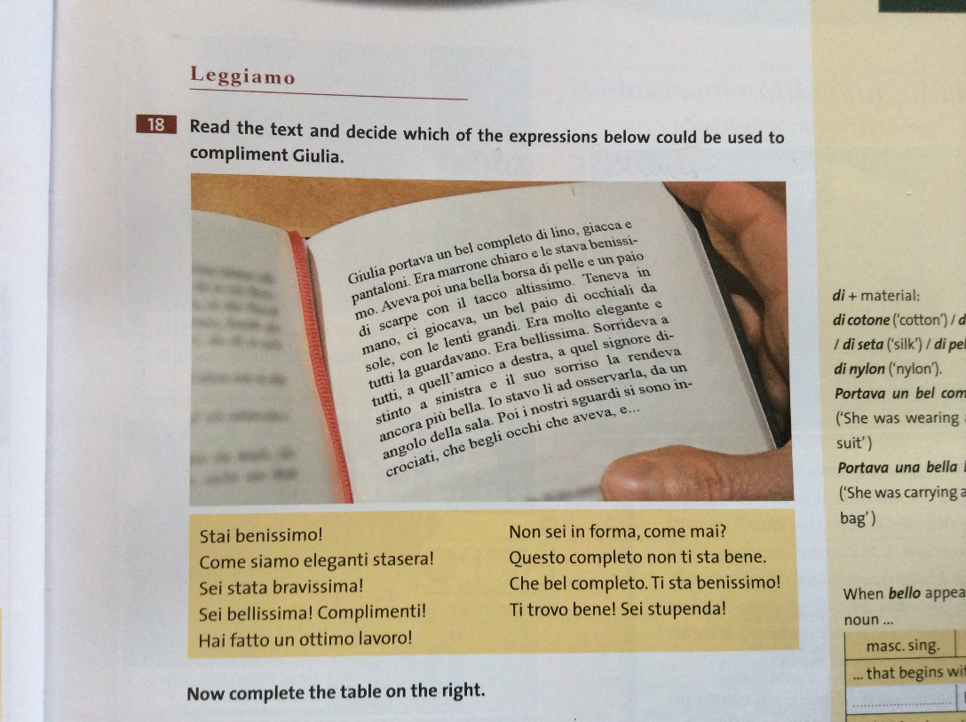
The Textbook:
Arrivederci! 2 for English speakers, F. Colombo,
C. Faraci, P. De Luca, Edilingua, 2013
Notes:
The Textbook:
(the audience is provided with a copy of the section from the textbook dealing with compliments and is asked to reflect upon eventual incongruities)

Slide 4
Reflection on the textbook:
Is my textbook adequate?
Do you see any incongruities?
How about contextualization?
Is anything missing?
Notes:
The appropriateness for presenting learners with good language models in the area of pragmatics is questionable: the textbook offered an inaccurate and sometimes decontextualized presentation of the different pragmatic aspects related to the complimenting examined, as well as a lack of natural conversation models representing the real use of the language. A possible explanation for this inadequacy is that the textbook relies heavily on native speakers’ intuition about norms of their community rather than on empirical research.
As such, I conducted my own research on Italian compliments based on literature on complimenting and natural data, not with the intention to provide generalizable findings but rather as a first step to a better understanding of L2 Italian teaching materials and a possible source of suggestions to integrate with the textbook.

Slide 5
My bag of tools to teach compliments
Functions
Syntactic pattern and lexical items
Social components
Notes:
I have put together a compliments bag of tools.
Now I can begin to conceive my class and I will proceed with my students exactly as I did for myself when I ‘became aware of my language’: I will expose them to authentic data and I will guide them to detect the different components upon which compliments are articulated.

Slide 6
Becoming aware of our own language by
collecting and examining literature resources;
gathering and observing authentic data.
Notes:
Becoming aware of our own language
My first achievement was becoming more consciously aware of my own language specifically in terms of patterns of compliments; this was absolutely essential for me as a teacher.
In fact, native speakers, having unconsciously mastered their L1 in childhood, may know the system of their language intuitively but they may lack explicit knowledge, more so when it comes to interactional practices and their mechanism. Therefore, it is important to examine the reality of language use in relevant educational settings and by gathering and observing authentic data.

Slide 7
Lesson plan
Step 1
Raise awareness of student’s own language
Students complete the charts by using their responses
to the practice given in Worksheet 1
Notes:
This step has the purpose of introducing students to and making them familiar with the charts they will use to practice with their L2.

Slide 8
Step 2
Introducing L2 dialogues
Students are given a dialogue in Italian to read (Worksheet 2).
Then they are asked to work on the following practices:
Notes:
With this step, students are exposed to a natural conversation in Italian. Then they perform some practices in order to distinguish the different functions that a compliment may have in a conversation. The authentic material we are using is an adaptation of a dinner party conversation reported by Giovanna Alfonsetti in I complimenti nella conversazione – Editori Riuniti university press, 2009

Slide 9
Group work
Identify and underline any form of compliment you find in the dialogue.
Then fill the ‘Functions Chart’ with your answers
Functions Chart
Students’ answers are corrected in plenum
positive evaluation greet or open a conversation, express gratitude, close a conversation, preface a request, positively reinforce desired behavior, soften criticism, assessment. | ________________________________________________________________________________________________________________________________________________________________________________________________________________________________________________________________________________________________

Slide 10
Step 3
Categorizing compliments strategy
Students fill in the chart they have used in Step 1 with the examples of compliments they have found in the previous practice
Notes:
With this activity, students work on how compliments are articulated according to their type.
(Audience is invited to do the same practice in Worksheet 3)

Slide 11
Worksheet 3
Fill in the following chart with the compliments you have identify from the dialogue in the previous step.
 | Type | Example
Head act strategy | Praise of performance / skills Praise of possession Praise of appearance
Internal modifier | Superlative Intensifier Exclamation Repetition
External modifier | Preparator

Slide 12
Reflection:
Reflect on your findings by answering the following questions:
Which syntactic and lexical items are more frequent and recurring in the formulation of the Italian compliments you have found?
verbs ________________________________________________________
adjectives _____________________________________________________
modifiers ___________________________________________________
Do any compliments for each situation seem inappropriate to you? If so, why?
____________________________________________________________________________________
____________________________________________________________________________________
____________________________________________________________________________________
Would you have uttered in your language the same compliments in a different way? If so, how?
____________________________________________________________________________________
____________________________________________________________________________________
____________________________________________________________________________________

Slide 13
Step 4
Categorizing Compliment Responses strategy
Students work on Compliment Responses: they first highlight them and subsequently they focus their attention upon the typology
Notes:
Audience is invited to work on worksheet 4

Slide 14
Worksheet 4
Underline the compliment responses you find in the Italian dialogue.
Then fill in the following chart listing the type of responses you have found.
 | Type | Example
Head act strategy | Token of appreciation Downgrading Disagreeing Avoiding the topic Questioning or requesting assistance Shifting the credit

Slide 15
Reflection
Reflect on your findings by answering the following questions:
What is the prevalent strategy used in responding to a compliment?
Have you noticed any difference between Italian and English in the way compliment responses are uttered?
Can you think of any cultural differences that may have determined the dissimilarity in compliment responses?

Slide 16
Step 5
A) Practicing with compliments
Students are asked to complete a dialogue in Italian and then they listen to the recorded version and correct their answers
Notes:
Audience is invited to check worksheet 5 from the handout

Slide 17
Che belle scarpe!
D: ____ _______________ scarpe che hai comprato! (Praise of possession: exclamation)
_____ ___________! (Internal modifier: superlative)
C: Mah, ___________ queste? (Compliment responses: downgrading)
D: Si’, si’ sono __________ come le volevo io: alte, bianche, con l’abbronzatura al piede … (intensifier)
C: [Senti io …
D: … sono ___________! (Internal modifier; superlative)
C: Senti io, veramente, queste scarpe me la hanno regalate. Eh:::, sono commode, pero’ io le trovo _____ particolarmente _________ (Compliment response: downgrading). Se vuoi te le … chiedo alla mia amica dove le ha prese e te le faccio prendere.
Notes:
In this first practice, we have guided the students’ answers by suggesting the type of strategy the speakers adopted in complimenting and responding to compliments.

Slide 18
B) Practicing with compliments
Students are asked to write a conversation in Italian between two friends. One of the two compliments the other about the after-lunch coffee she has made.
Subsequently students listen to the recording of an authentic conversation in Italian and compare their answers with the original dialogue.

Slide 19
I Complimenti nella Conversazione, Giovanna Alfonsetti, Editori Riuniti university press, 2009
Comparing Textbooks and TV Series as Sources of Pragmatic Input for Learners of Italian as Second language: the Case of Compliments and Invitations, Elena Nuzzo in Teaching Learning and Investigating Pragmatics, Gesuato, Bianchi, Cheng, Cambridge Scholars Publishing, 2015.
The Variability of Compliment Responses: Italian and German Data, Marina Castagneto and Miriam Ravetto, in Teaching Learning and Investigating Pragmatics, Gesuato, Bianchi, Cheng, Cambridge Scholars Publishing, 2015.
Have You Paid Someone a Compliment Today?, Jessie Carduner, in Pragmatics: Teaching Natural Conversation, N. R. Houck and D. H. Tatsuki, Tesol, 2011.
Male and female Complimenting Behavior, Anne McLellan Howard, in Pragmatics: Teaching Natural Conversation, N. R. Houck and D. H. Tatsuki, Tesol, 2011.

Slide 20
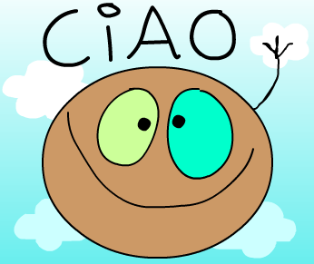
… e grazie!!!!

