Slide 1
Teaching intercultural knowledge:
Rejecting an invitation & pursuing acceptance
Rice CLIC Workshops for L2 teachers
Kevin García Cruz
Center for Languages & Intercultural Communication

Slide 2
Outline:
Intercultural knowledge
Teaching unit: Invitations
Your turn (group work)
Other learning targets (interactional patterns w/ specific sociocultural norms)

Slide 3
Intercultural knowledge

Slide 4
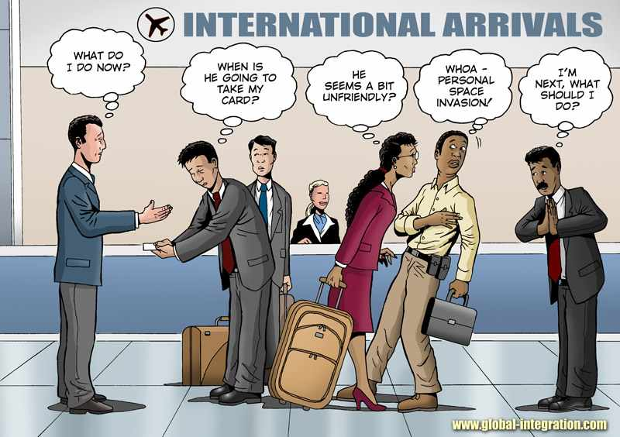
Intercultural knowledge
The ability to:
“...communicate competently within and across linguistic and cultural boundaries.”
(Huth, 2010, p. 154)
“...adapt to the interlocutor’s cultural style to work out the most fitting conversational, social and politeness strategies, which are essential for effective communication.”
(Barraja-Rohan, 1999, p. 156)

Slide 5
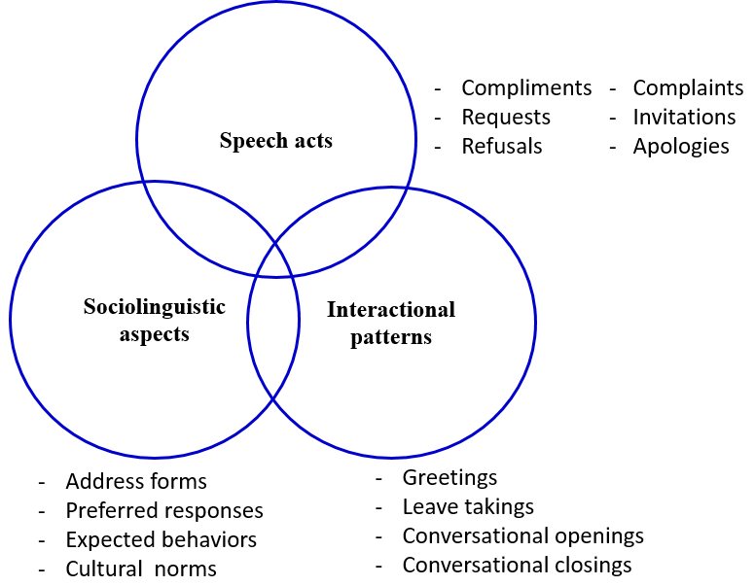

Slide 6
What is intercultural knowledge/competence?
→ Knowing the “secret rules” of the target language.
→ Being able to comprehend, construct, and convey meanings (verbally and in writing) in ways that are accurate and appropriate for the specific context (social, cultural, etc.) in which communication takes place.

Slide 7
Teachable elements:
Speech acts and interactional patterns (w/ sociocultural norms)
Apologizing
Complementing
Accepting or declining invitations and requests
Seeking acceptance after a refusal
Openings and closings in a conversation (phone and face-to-face)
(Barraja-Rohan, 1997)

Slide 8
Teaching unit: Invitations
Second semester Spanish

Slide 9
Lesson goals:
Recognize common practices used to seek acceptance after a rejection.
Become aware of the act of insistence as an expected politeness strategy (cultural expectation) among Spanish-speaking groups.
Compare/contrast refusal and insistence practices in the L1 and L2.

Slide 10
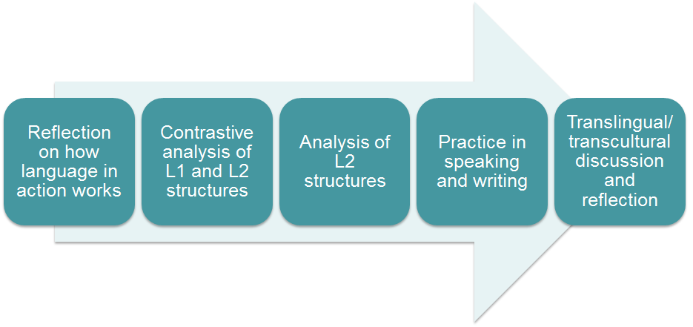
Pedagogical phases (From Betz & Huth 2014, inspired by Barraja-Rohan, 1997)

Slide 11
See handout packet
(pages 2-9)

Slide 12
Phase 1:
Students begin to think about how refusals and insistence (after an invitation) work in English.

Slide 13
Phase 2:
Students compare/contrast both dialogues to become aware of the interactional resources used to refuse an invitation or to pursue acceptance.

Slide 14
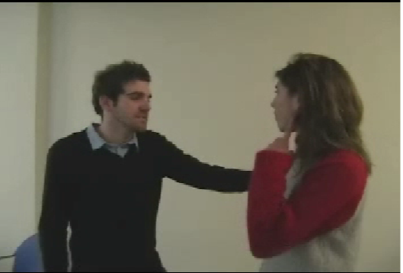
Phase 3:
Students are guided to identify the interactional resources used to politely refuse an invitation and those used to pursue acceptance after a refusal. Students will notice how the invitation is re-extended multiple times with the goal of making the invitation sound very sincere and the invitee wanted.

Slide 15
Phase 4:
Students put into practice refusing an invitation and pursuing acceptance.

Slide 16
Phase 5:
Students are asked to reflect on the conversational structure just learned and how it compares to similar practices in their L1, English or other.

Slide 17
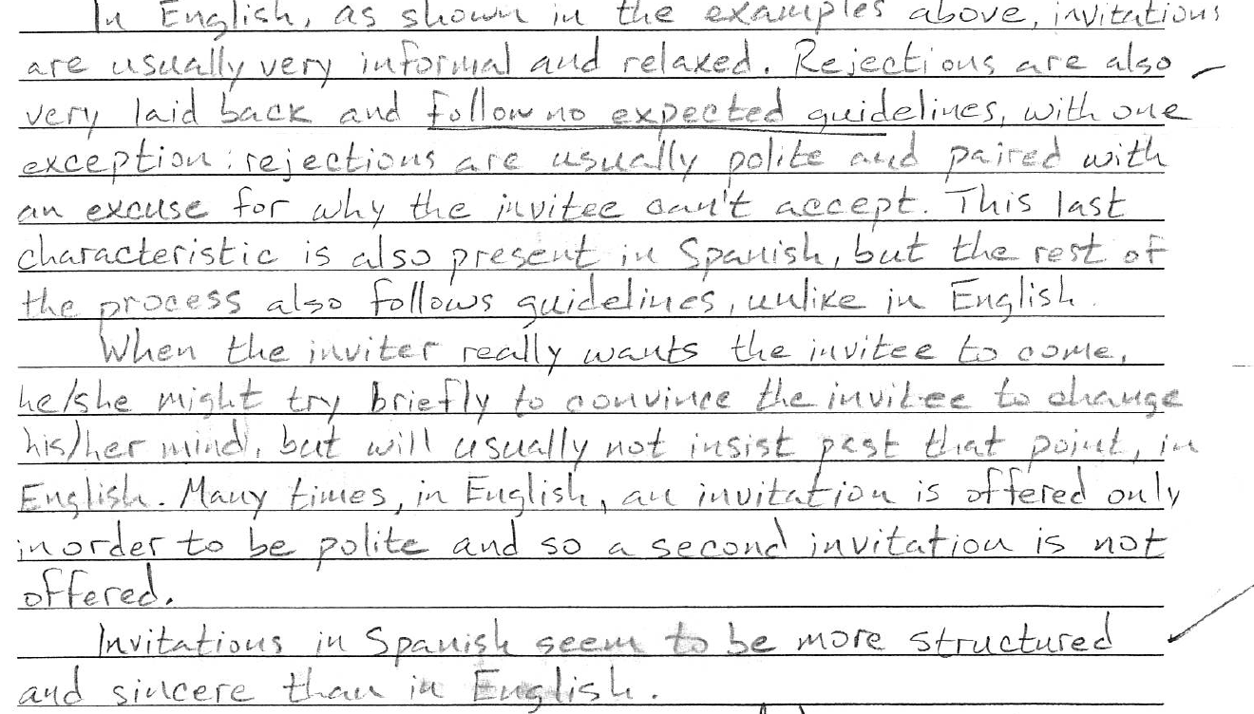

Slide 18
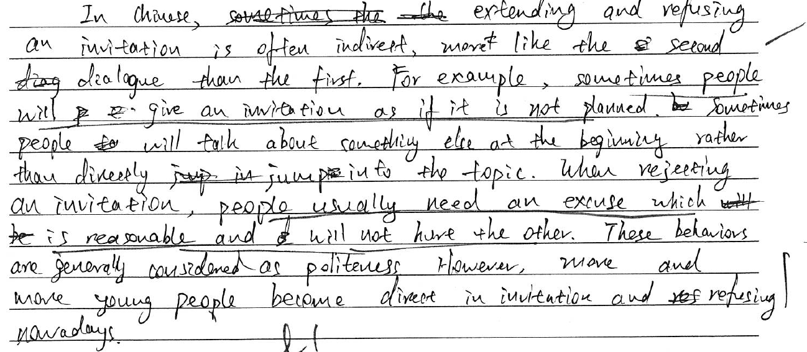

Slide 19
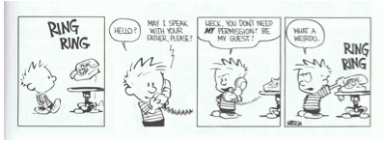
Group work
Creating learning targets

Slide 20
Creating a lesson on the “grammar of conversation”
Study the conversations provided in your handout and...
identify at least one speech act and/or interactional pattern,
discuss with your peers possible socio-cultural norms associated with the feature/pattern selected,
design a task (activity) for one of the pedagogical phases discussed today.
Write a general description for activity.
Specific learning goal(s).
Instructions for students.
Present task

Slide 21
FinFi
In your opinion, what are the benefits of teaching intercultural knowledge in the language classroom?
What challenges do you foresee in trying to incorporate the teaching of intercultural knowledge into your current syllabi and curricula?

Slide 22
QUESTIONS?

Slide 23
iGracias! / Thank you!
Kevin García Cruz
RICE-CLIC
Kevin.Garcia.Cruz@rice.edu

