Slide 1
TEACHING AND ASSESSING Interactional Competence Redesigning the language curriculum
Maryam Emami
CLIC SUMMER WORKSHOP
Rice University
Summer 2016

Slide 2
Understanding Interactional Competence
Interactional competence:
Is about the relationships between the way speakers talk and the social contexts in which they are talking.
Is the “ability to make relevant and fitting contributions to an ongoing conversation in an orderly way” (Huth, 2015), with a variety of other speakers in a variety of settings.
Is focused on how two or more speakers co-construct conversation in context, rather than on how one speaker uses language in context (Pekarek Doehler, 2016).

Slide 3
Interactional Practices
Active participation→ Being active in co-constructing the conversation
Topic management → How participants select and expand & shift the topic of the conversation
Turn-taking → How participants select the next speaker and how participants know when to end and begin one turn
Repair → The ways in which participants respond to interactional trouble in a given situation

Slide 4
“WHY” a focus on INTERACTIONAL COMPETENCE
Lack of conversational skills even beyond the second year of instruction
Limited focus on interactional opportunities
Teaching of interactional practices→ A missing piece
in the curriculum

Slide 5
Where it all started, Spring 2015

Slide 6
SAMPLE 1
1 Students: Hello!
2 Native: Hello! - My name is Cécile.
3 Students: My name is Nickolas and my name is Erik
4 Native: Nice to meet you!
5 Native: So are you two in the same class? […]
6 Students: Yes
7 Native: Great. In which year are you? […]
8 Students: Um…
9 Native: Is it your first year? second year?
10 Student 1: Oh yes, first year
11 Student 2: Second year
12 Native: Me, too. It’s my first year, but for the masters.
What happens right after lines 5 & 7 when learners are asked a question? How could have the learners reacted differently in response to each question?
3. What do you observe in line 12?

Slide 7
Sample 2

Slide 8
Sample 2
1 Native: She told me that there was a really cool video of the last conference.
2 Student 1: mmhm
3 Native What is this video?
4 Student 1: It is… It’s great.
5 Native: What did they do in the video?
6 Student 1 It is… huh?
7 Native: What did they do, what is the video?
Because I haven’t seen it. I just heard that it was cool.
8 Student 1: Yes
9 Native: What was on the video?
10 Student 1: uh...
11 Native: Can you tell me a little bit about what was on the video?
For example, I don’t know..
12 Student 2: What are you doing in the video?
12 Student: Oh swimming
1. What is happening in line 2? 2. What could be an appropriate reaction in line 2? 3 Are responses in lines 4 & 8 appropriate? Explain.
4. Can you see a pattern among responses 2,6 & 10? Explain your response.

Slide 9
Observations
Sample 1 & 2 are perfect examples of learners lacking interactional practices such as:
Repair → asking for clarification, repetition
Being active participants → expanding
→ asking follow-up questions

Slide 10
“When” can Interactional Competence being included in the curriculum?
Planting the seeds as early as the first semester of instruction by using:
Samples of L1 speakers
Simplified activities based on collected recordings

Slide 11
Why native speakers’ recording?
Wong was among one of the first applied linguists to argue that
second language learners can benefit from study of transcriptions of recorded naturally occurring conversations in order to learn how participants construct, reconstruct and orient to social actions.
Interactions between natives are:
An instructional live model that students could relate to
A missing piece in most textbooks

Slide 12
“HOW” → Structure & implementation
At the beginning of the semester, students are asked to:
Choose a classmate and meet with an advanced or L1 speaker
Talk for about 5-10mins (no topics are assigned)
Videorecord your conversation
Complete the “self-assessment checklist” and “a reflection”
Removing the examiner from the equation

Slide 13
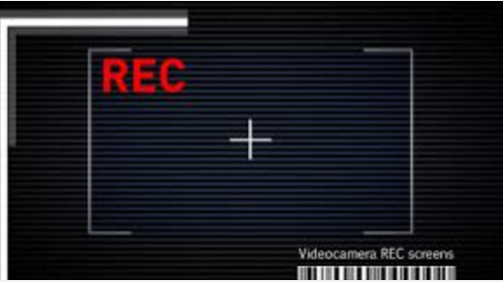
Benefits of videorecording
Importance of body language
More accurate & valid assessment of the interaction
A reference point
Used as a teaching tool
Used as an assessment tool

Slide 14
Connecting the dots …
Practice
Students video-record their first conversation with an L1/advanced speaker
Awareness
Students reflect on their own performance and receive feedback from the instructor

Slide 15
Classroom instruction
Students are guided through the analysis of specific interactional practices in “real” conversations
Awareness
Students transcribe and analyze a few turns of their own interactions
“Interactional features need to be taught in context through the use of recorded and transcribed naturally occurring conversations, which will form the basis of the lessons.” (Barraja-Rohan, 2011)

Slide 16
Bridging the gap: Linking Teaching & Testing Practices
Classroom assessments do more than just measure learning. They send a clear message to students about what is worth learning, how it should be learned, and how well we expect them to perform.

Slide 17
Bridging the gap: Linking Teaching & Testing Practices

Slide 18
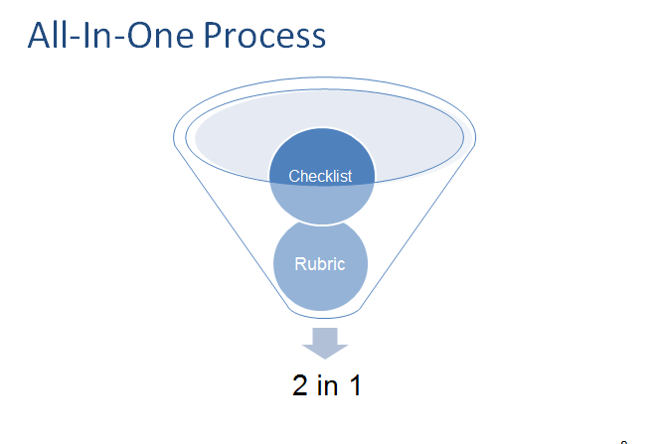
Development and use of an “assessment tool”
elf-Assessment checklist

Slide 19
THANK YOU! Q & A
Notes:
fdgfgf

