Slide 1
Expanding the Communicative Approach: Guided Induction
Luziris Pineda Turi
lpturi@rice.edu

Slide 2
The State of Your Language Classroom
Consider the last two language textbooks you used. How did they structure the introduction of a new grammar topic? What are the pros and cons of these particular structures?
Now, consider the current pedagogical structure of a typical lesson plan for your course. What is the usual structure of a class dedicated to presenting a new grammar concept?

Slide 3
Communicative Approach: Two Publishers' Interpretation
Spanish textbooks and the Presentation-Practice-Production Cycle:
Verb tense chart
Verb tense explanation
In-class practice: Fill-in-the-blank, GAP exercises, matching, crossword puzzles, etc.
Assessment: Similar to textbook exercises

Slide 4
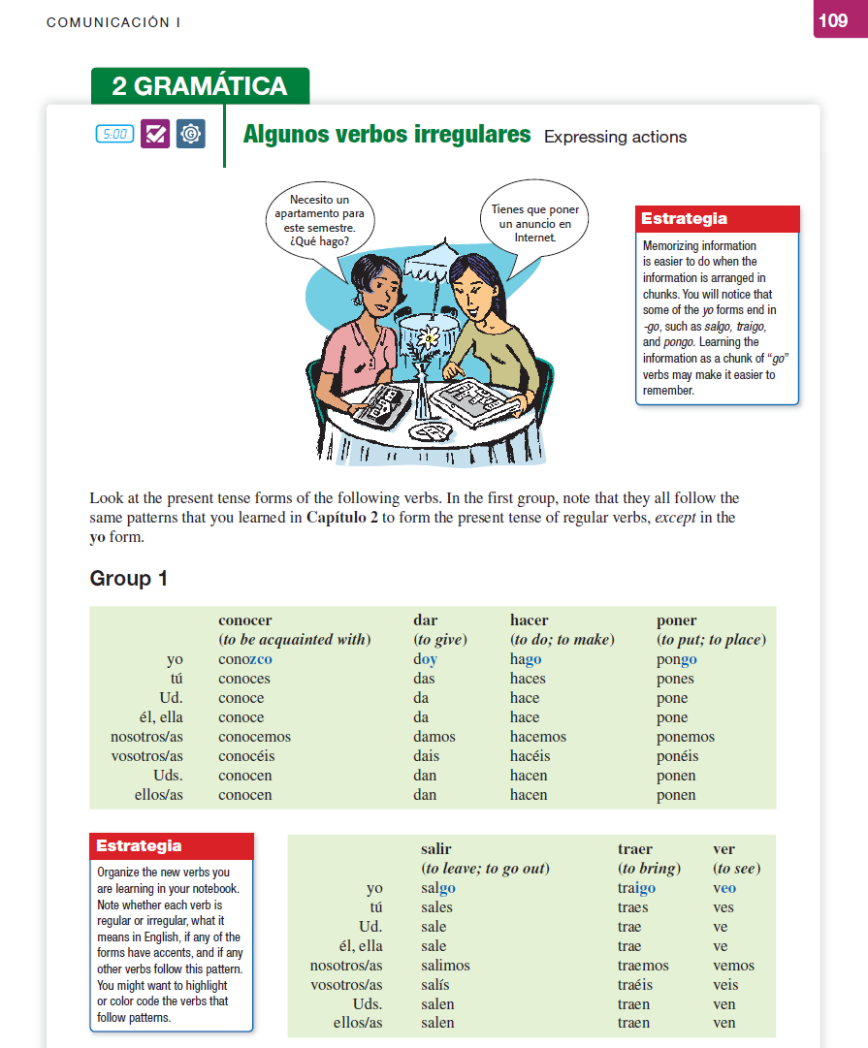
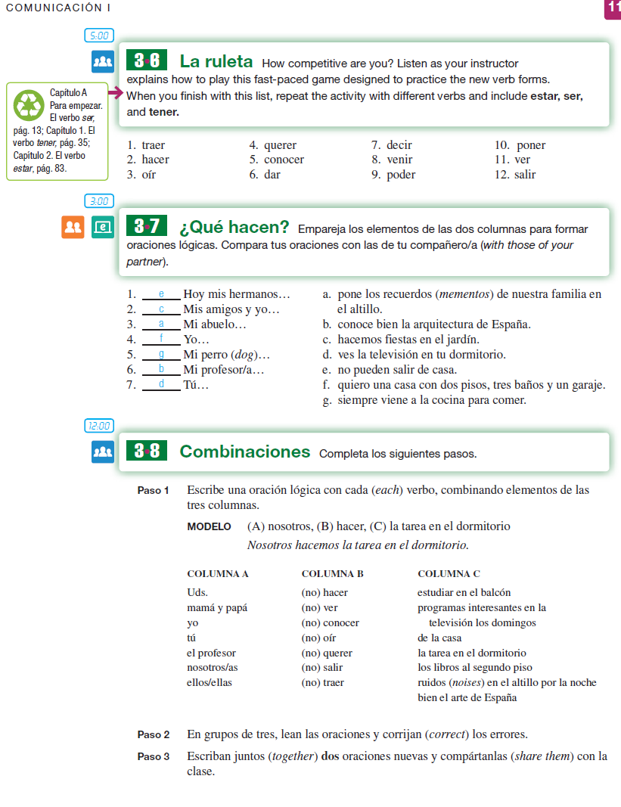
Communicative Approach: Two Publishers' Interpretation

Slide 5
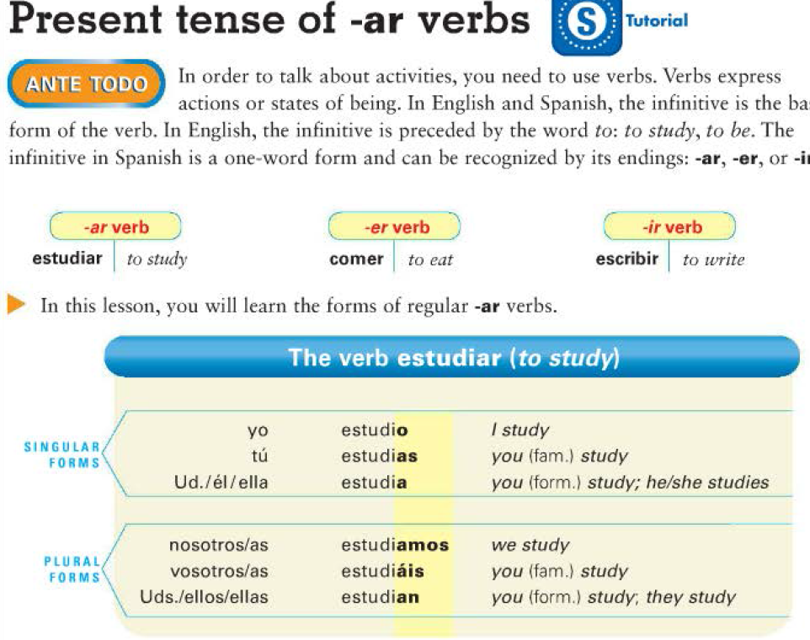
Communicative Approach: Two Publishers' Interpretation

Slide 6
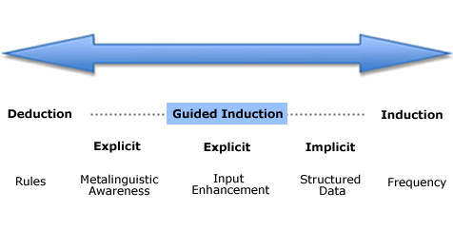
Inductive-Deductive Continuum

Slide 7
Enhancing Your Current Pedagogy
The enhancement of the communicative approach could include Guided Induction.
CLIC’s interpretation of this includes the following features:
Use of authentic language data
Enhanced input but not overly structured
Language Analysis
Language Awareness
Student-centered

Slide 8
Your Own Interpretation
What would a lesson plan look like if it included guided induction?
Possible topics:
Vocabulary
Articles
Pronouns
Verb tense
Particles
Formality/Informality

Slide 9
Sample Lesson: Articles
Give students a series of nouns with articles
Ask students to analyze.
Give students a series of nouns without articles so that they can complete them while using original samples as a guide.
Ask students to identify the pattern/rules.

Slide 10
Sample Lesson: Verb Tenses
Use of selected authentic data:
Interviews
Conversations between L1 speakers
Text messages
Emails
Text messages
Series of guided questions for the analysis of the data
Second set of language data for confirmation of conclusions
Production of similar task as presented in the authentic data:
Audio of storytelling ---> Students then story tell

Slide 11
http://Sample Lesson Plan: Narrating in the Past/

Slide 12
Conclusions and Considerations
Conclusions
Focus on enhancing the communicative classroom
Guided Induction
Student-centered
Analytical/Critical thinking
Use of authentic data
Considerations
Necessary modifications for 1st year
Investment of time
Database of authentic data
Balance with other methodologies

