Slide 1
Using Authentic Materials to Design Classroom Activities
CLIC Summer Workshop for L2 Teachers
August 12-13, 2016
Aymara Boggiano

Slide 2
Outline
Authentic Materials
Concept – Types
Selecting & Preparing Authentic Materials
Distinguishing Scripted From Unscripted Materials
Retake on Authentic Materials: Corpora
Preparing Materials
Using Authentic Materials to create classroom activities
3 Examples

Slide 3
Authentic vs Non-authentic Materials
Non-Authetic: print, video, or audio materials
Designed to look like authentic materials:
Ex: found in textbooks
Not intended to be used by native speakers
Authentic materials: print, video, or audio
Used in daily lives: Ex: a menu from a restaurant
Created, but not specifically for teaching: Ex: Commercials
Intended to be used by natives speakers.

Slide 4
Importance of using Authentic Materials
Exposes learner to same language as a native speaker
Gives learner opportunity to observe and analyze vocabulary, grammar, pragmatic and cultural aspects of the language.
Gives authenticity to:
learner’s interpretation of language
tasks conducive to language learning
Offers immediate proof that the language is used for real -life by real people.
Has a positive effect on student's motivation

Slide 5
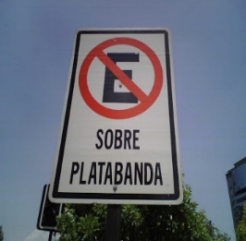
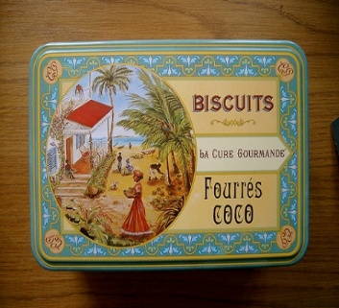
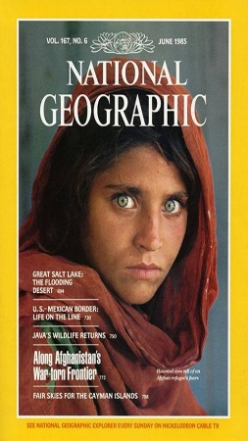
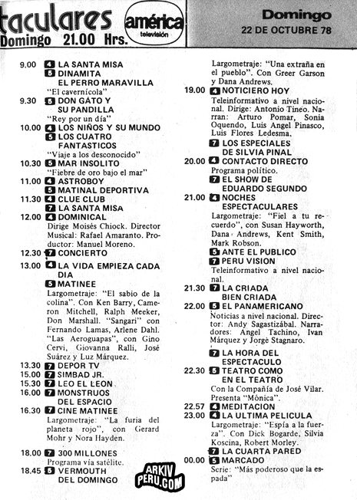
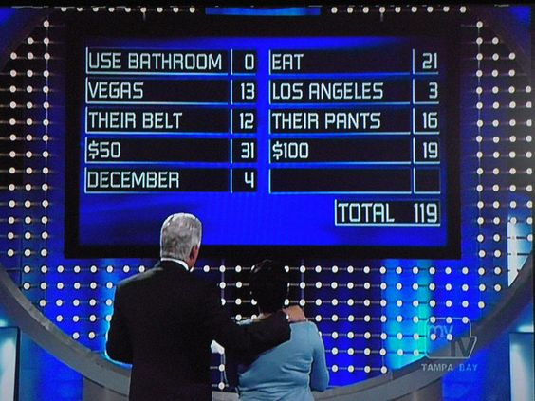
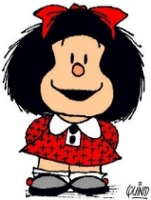
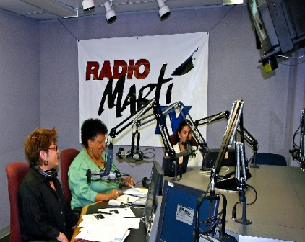
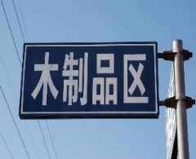
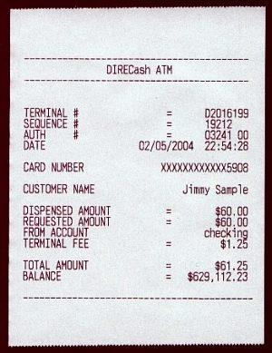
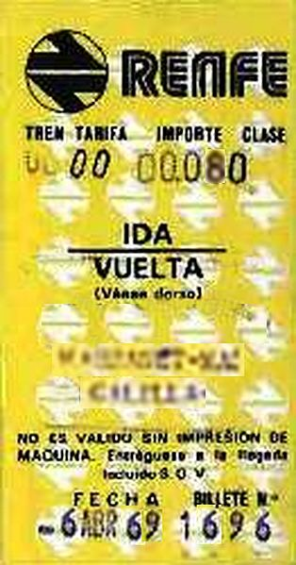
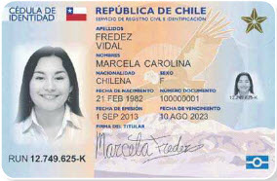
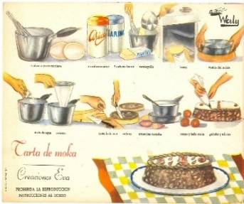
Authentic Materials
Print or Digital written materials
Digital Audio/video materials
Utility bills
Packing slips
Order forms
ATM screens
ATM receipts
Web sites
Street signs
Coupons
Traffic tickets
Greeting cards
Calendars
Report cards
TV guides
Food labels
Magazines
Newspapers
Advertisements
Phone messages
Radio broadcasts
Podcasts
E-books
Movies
Videos and DVDs
Television programs
Recorded interviews

Slide 6
Authentic Materials
Have you ever collected these type of materials?
Make a list of as many examples as you can that you have collected
Write a check mark next to the ones you have actually used in a lesson plan
Share the information with a partner
Use Handout 1

Slide 7
On our list of Authentic Materials, are there any that can be used to teach Communicative Practices?
Use Handout 1

Slide 8
Authentic Materials
Print or Digital written materials
Digital Audio/video materials
Utility bills
Packing slips
Order forms
ATM screens
ATM receipts
Web sites
Street signs
Coupons
Traffic tickets
Greeting cards
Calendars
Report cards
TV guides
Food labels
Magazines
Newspapers
Advertisements
Phone messages
Radio broadcasts
Podcasts
E-books
Movies
Videos and DVDs
Television programs
Recorded interviews

Slide 9
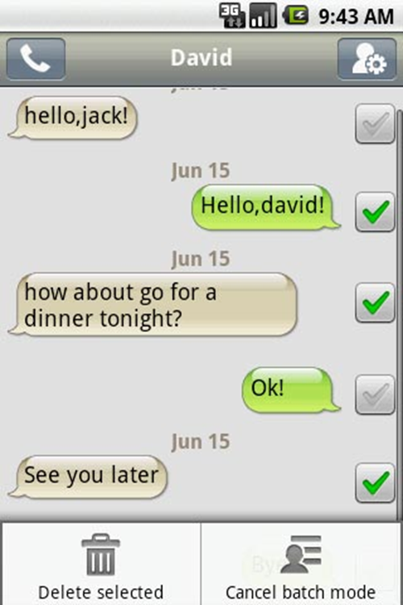
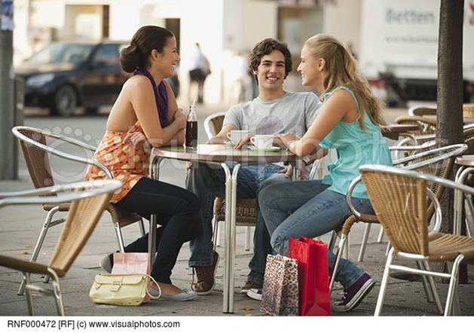
Authentic Conversational Materials Where are they?
Naturally occurring conversations L1-L2 & L1-L1
1. Telephone Conversations
2. Recorded multimedia conversations
(sms, Skype, FB, etc.)
3. YouTube conversations
4. Commercials showing naturally occurring conversations
5. Snapchats
6. Conversations in different settings and contexts:
Office Friends: café, party
Neighbors Strangers in the street
Store Coffee shop
Family conversations Classmates
Medical: Dr.’s office
Business: meeting, phone negotiations

Slide 10
Scripted and Unscripted Conversation
Would you say these conversations are scripted or unscripted?
Conversation 1: Meeting
Conversation 2: Two college friends
Conversation 3 Travel Agency
Conversation 4 Two Friends
Use Handout 1

Slide 11
What is wrong?
Which one would you eliminate?
Which one would you keep? Why?
Natural/Unnatural
Fluency/speed of delivery
Ennunciation
Accent
Exchange of information without social interaction
Affective component
Interlocutors making connections
Expressions of Interactivity: reactive tokens, particles
Use Handout

Slide 12
Creating Authentic Conversational Materials to teach Communicative Practices
Use the web:
Commercials
Real conversations – YouTube- Podcasts
Snapchat
TV programs – reality shows – game shows
Collect your own Corpora of Video and/or Audio recordings of conversations
Use materials from students assignments: (get permission)
Recorded student’s conversations with native speakers
Recorded Videoconferences with native speakers (New pen pal)
Recorded conversations during study abroad programs (Naoko Osaki)
Between friends or conversation partners abroad
With families in home stays
Problems?
Use a Corpus: Collection of authentic language data (Handout 4)
http://clicmaterialsld.blogs.rice.edu/

Slide 13
Using a Corpus
Corpus: Collection of authentic language data (Handout 4)
http://clicmaterialsld.blogs.rice.edu/
Conversations student w/ native speakers
Conversation by native speakers
Business recordings:
Business meetings
Student’s conversations with business executives
Medical:
Interviews with healthcare professionals
Doctor-patient mock interviews by native speakers
Real Doctor-Patient Conversations:
14 recorded in a local physician’s office
7 recorded in China

Slide 14
Preparing Conversational Materials for use in the classroom
Choose appropriate useful recordings
Choose a section that display the content to be learned (less is more)
Transcribe:
Direct transcription (Vocab/Grammar/Syntax)
One shows non-verbal features using notations
Useful notations:
[ ] Overlapping turns
Handout 2
Use ELAN (The language Archive) Software to reduce speed, pause a recording https://tla.mpi.nl/tools/tla-tools/elan/download/

Slide 15
Using Authentic Materials
Handout 2
A commercial from Venezuela: Mercantil Móvil Empresas
Handout 2.1
An Interview from Mexico: El Rol del abogado
Handout 2.2
A Documentary from Chile: Conversaciones en un Taxi

Slide 16
Total Language Package
Continue to include:
Grammar and Vocabulary*
Reading and Writing
Listening and Speaking
Add:
Unscripted spoken conversations to learn communicative practices
Needs:
*Some redirecting of grammar and vocabulary
*Authentic Conversational Materials

Slide 17
Thank you!
Any questions
or
comments
aymara.boggiano@rice.edu

Slide 18
BARRAJA-ROHAN, A.-M. (2011). “USING CONVERSATION ANALYSIS IN THE SECOND LANGUAGE CLASSROOM TO TEACH INTERACTIONAL COMPETENCE”. LANGUAGE TEACHING RESEARCH, 15(4), 479–507. BETZ, E., & HUTH, T. (2014). BEYOND GRAMMAR: TEACHING INTERACTIONAL IN THE GERMAN LANGUAGE CLASSROOM. DIE UNTERRICHTSPRAXIS/TEACHING GERMAN, 47, ­140–163. CESTERO, ANA M. (2005).CONVERSACIONES Y LA ENSEÑANZA DE LENGUAS EXTRANJERAS. MADRID: ARCO LIBROS 2. JACOBSON, E., DEGENER, S., & PURCELL-GATES, V. (2003) CREATING AUTHENTIC MATERIALS AND ACTIVITIES FOR THE ADULT LITERACY CLASSROOM: A HANDBOOK FOR PRACTITIONERS . NCSALL TEACHING AND TRAINING MATERIALS. BOSTON, MA: NCSALL AT WORLD EDUCATION. 3. PURCELL-GATES, V., DEGENER, S., JA COBSON, E., & SOLER, M. (2001) TAKING LITERACY SKILLS HOME. FOCUS ON BASICS, 4 (D), 19-22 4. WRIGLEY, H. (2003). A CONVERSATION WITH FOB: WHAT WORKS FOR ESL STUDENTS FOCUS ON BASICS, 6 (C), 14-17
Berardo, Sacha (2006) Use of authentic materials in the teaching of reading.The Reading Matrix Vol. 6 No. 2
References

