Slide 1
Integrating Revised Bloom’s Taxonomy (RBT) with authentic materials to improve teaching, learning, and assessing in CFL contexts
Jing Yu （俞菁）
University of California, Santa Barbara
Notes:
认识论：我能够知道什么？

Slide 3
3H Domains:
Head
Hand
Heart

Slide 4
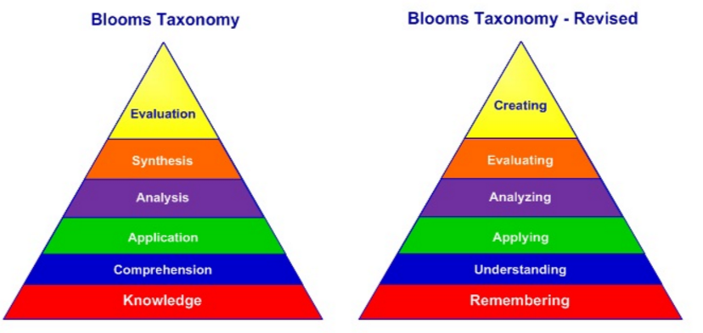
Benjamin Bloom (1956)
Lorin Anderson (2001)

Slide 6
Before you can understand a concept, you must remember it.
To apply a concept, you must first understand it.
In order to evaluate a concept, you must have analyzed it.
To create an accurate conclusion, you must have complete a thorough evaluation.
Hierarchical Nature

Slide 7
Notes:
介绍Bloom’s wheel

Slide 9
How to ask questions by using Revised Bloom’s Taxonomy (RBT)?

Slide 10
Bloom’s Taxonomy is a tool for assessment:
Assess learning
Assess the standard or learning objective
Determine the level of a learning objective
Evaluate alignment between curriculum, instruction, and assessment
Notes:
Factual knowledge:
Knowledge of terminology
Knowledge of specific details and elements
Conceptual knowledge:
Knowledge of classifications and categories
Knowledge of principles and generalizations
Knowledge of theories, models, and structures
Procedural knowledge:
Knowledge of subject-specific skills and algorithms
Knowledge of subject-specific techniques and methods
Knowledge of criteria for determining when to use appropriate procedures
Metacognitive knowledge:
Strategic knowledge
Knowledge about cognitive-tasks, including appropriate contextual and conditional knowledge
Self-knowledge

Slide 12
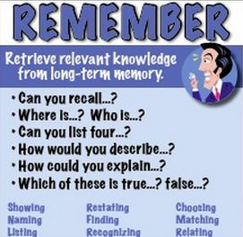
In-classroom instruction:
Can you recall the six levels of Revised Bloom’s Taxonomy?
What’s the difference between the old version and new version?
Assessment:
Multiple choice
Which of these are lower thinking skills___; which of these are higher thinking skills____.
Remembering
Understanding
Applying
Analyzing
Evaluating
Creating

Slide 13
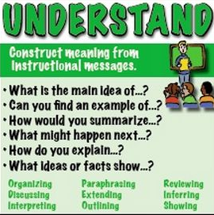
In-class instruction:
Can you find an example of level five “evaluating”?
What might happen next “creating”?
Assessment:
Short answer
Please summarize each stage, and tell me which one do you think is the most important?
______________________________________________________________________________________________

Slide 14
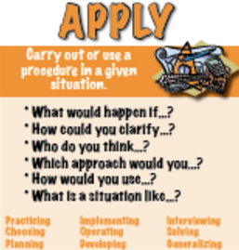
In-class instruction:
How to apply Revised Bloom’s Taxonomy into your own classroom, including curriculum, instruction, and assessment?
How could you clarify this cognitive process to your colleagues?
Assessment:
Role play
Suppose I am your supervisor, you plan to design your course by using Revised Bloom’s Taxonomy. How to persuade me?

Slide 15
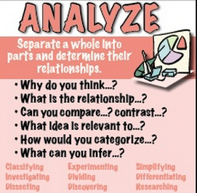
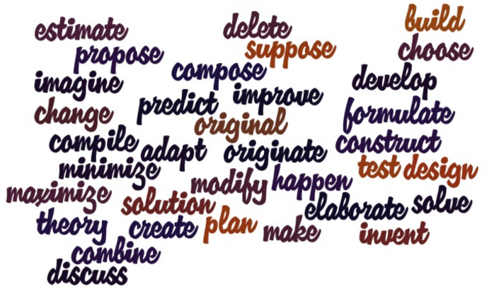
In-class instruction:
Can you compare and contrast the third (applying) and fourth (analyzing) stage?
Which one do you think is more important than the other? Why?
Assessment:
Please categorize the following verbs into different layers

Slide 16
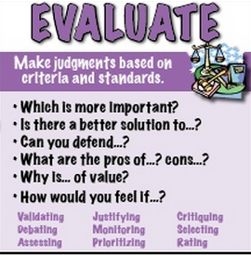
In-class instruction:
Why Revised Bloom’s Taxonomy stands out in the development of education?
How would you feel if it can be used in other content areas, such as mathematics, social science?
Assessment:
Short essay
Please critique Revised Bloom’s Taxonomy .

Slide 17
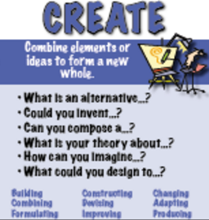
In-class instruction:
If you can add or delete one level of cognitive process, what do you want to add and what do you think it’s redundant?
Assessment
Group project
You need to design a course by using Revised Bloom’s Taxonomy, including learning objectives, classroom activities, and assessment. Presentation is needed.

Slide 18
Learning outcomes:
By the end of the session, learners will be able to:
All -- name the six levels of the Revised Bloom’s Taxonomy.
Most -- apply to the curriculum design, instructional activities and assessment.
Some – argue its pros and cons in the real situation.
All – understand different verbs in different stages
Most -- compare and contrast different stages
Some – deconstruct the Revised Bloom’s Taxonomy to explain its value.

Slide 19
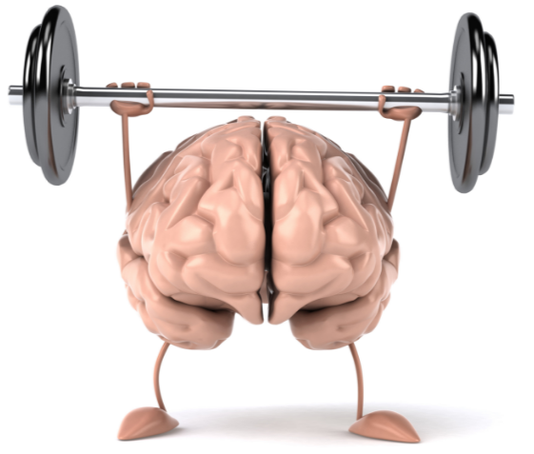
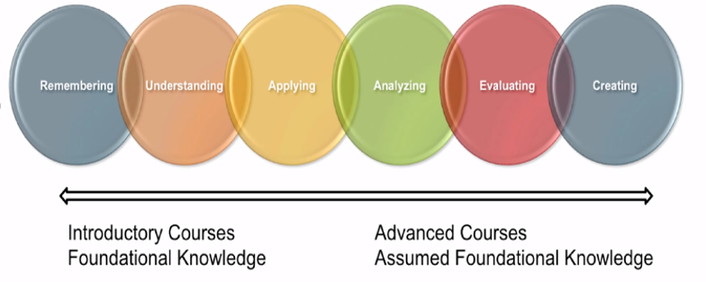

Slide 20
Q & A

