Slide 1
Listener responses as stance display:
Reactive expressions and their uses in daily Mandarin conversation
I-NI TSAI
initsai@ntu.edu.tw
Graduate Program of Teaching Chinese as a Second Language
National Taiwan University
2nd INTERNATIONAL CONFERENCE ON CHINESE SPOKEN CORPORA 2016, Rice University

Slide 2
About this study
Focus of inquiry
  reactive expressions (vs. backchannels/ listener responses)
Data
  Data consists of 4 hours of video recorded naturally occurring daily conversations by native speakers of Mandarin Chinese from Taiwan
  Conversations collected took place in natural social settings, such as regular get-togethers or after-class hangouts.
The purpose of this study is twofold
  (a) to provide an overview of frequent reactive expressions used in
  daily conversations in Taiwan Mandarin
  (b) to analyze the stances these expressions are used to display

Slide 3
Background-1
  Conversation is achieved through the turn-taking system and adjacency pairs.
001 Anne: 喔,我覺得-我沒有去那個公園.
(0.3)
002 Iris: 喔,你沒去嗎.
003 Anne: mm.
004 Jack: 喔,那個公園沒什麼.ehuh[hhh.
005 Anne: [↑en,真的嗎.
006 Iris: =聽說還蠻[漂亮.
007 Bill: [不好看.
008 Iris: [不好看嗎?
009 Anne: [真的喔.
010 Bill: ((點頭))˚hen.
011 Jack: 那個公園沒什麼好看.
First pair part
Second pair part
Third position
First pair part
Second pair part
Third position

Slide 4
Background-2
Conversation
  from Conversation analysis point of view (Sacks, Schegloff, & Jefferson, 1974)
  Conversation is achieved through the turn-taking system and adjacency pairs.
  Participants constantly monitor each other and negotiate the information status and their stances.
  Conversation emerges through sequences, i.e. every utterance bit by bit shapes the trajectory of the unfolding talk.
  Conversation is a highly interactive and collaboratively co-constructed activity.
    Listeners contribute as much as speakers to ongoing conversations
    It is essential to understand listener responses

Slide 5
Prior studies-1 Backchannels
Listener responses have been investigated under different names
  Yngve (1970): “backchannels” or “backchanneling”
      the feedback non-primary speakers produce in verbal communication
  White (1989): Backchannels
    Backchannels reflect cultural differences
    Japanese speakers display several types of backchannels far more frequently
  Duncan (1974): auditor backchannel signals
    requests for clarification
    nonverbal feedback

Slide 6
Prior studies-2 Reactive tokens
  Clancy et al. (1996): “reactive tokens” as a cover term
      Backchannels (i.e., non-lexical minimal tokens like mhm or uh huh) <continuer>
      Reactive expressions (i.e., lexical phrases or words like yeah, sure and exactly)
      Collaborative finishes
      Repetitions
      Assumptive openers
  Young & Lee (2004)
    Reactive tokens in Korean and English conversations

Slide 7
Prior studies-3 Turn-initial Tokens
Conversational collaboration is constructed through turn-taking system, in which turn-initial position plays a particular significant role (Kim & Kuroshima 2013).
The turn initial position creates coherence as it has both retrospective and prospective orientation (Schegloff, 1996).
  the tokens used in the turn initial position display speaker’s understanding of or stances/ alignment toward what has been said before
  the tokens used in the turn initial position foreshadow what unit or action will come next in the unfolding talk (projection and preface/prefacing) (Sacks, Schegloff, & Jefferson, 1974; Schegloff, 1980; Streeck, 1995).

Slide 8
Prior studies-3 Turn-initial Tokens
    Oh as a change-of-state token (Heritage 1984); “Oh”-prefaced response indicates the question is problematic (Heritage 1998)
    Yeah displays speaker’s agreement and operates as a preliminary to recipient topic-shift (Jefferson 1984, Zimmerman 1993)
    uh huh as a continuer (Schegloff, 1981)
    mm as a weak minimal acknowledgement (Gardner 1997)
    Well-prefacing in response to a wh-question serve as a general alert to the nonstraightforwardness of the answer (Schegloff & Lerner 2009).
    Eh-prefacing in Japanese marks a “noticing of departure” (Hayashi 2009)
    Ei-prefacing (“no”-prefacing)in Estonian halts the ongoing action to achieve mutual understanding (Keevallik 2012)
    EI-prefacing (in rising intonation) in Mandarin manages incipient turn entry (Wu 2014)

Slide 9
Listener responses in Chinese-1
  Tao and Thompson (1991)
    English backchannels in Chinese conversation
    Second language can influence the use of the first language: Superstratum influence on discourse strategies
  Clancy et al. (1996)
    English, Japanese and Chinese
    Reactive tokens: English and Japanese > Mandarin
Clancy et al. 1996: p. 370

Slide 10
Listener responses in Chinese-2
  吳 (2001)
    The distribution of types and functions among different groups of speakers (couples, friends, teacher-student etc.)
      types: particles (啊), lexical word (對), repetitions, and the mixed type
      functions: displaying receipt, understanding, and attitudes (agreeing, casting doubts, confirming, indicating surprise, and others)
      More familiar more lexical words to display attitudes, particularly casting doubts
  Deng (2008): Australian English and Chinese
    Australians use more listener responses, use a higher percentage of lexical expressions as their listener responses
    Chinese speakers use fewer listener responses, favour the use of paralinguistic vocalic forms as their listener responses
Wang et al. (2010)
    dui and hao in spoken Taiwan Mandarin
    Particular emphasis on comparison between
      hao/hao la/hao a/hao le/hao ba
      dui/dui a/dui le

Slide 11
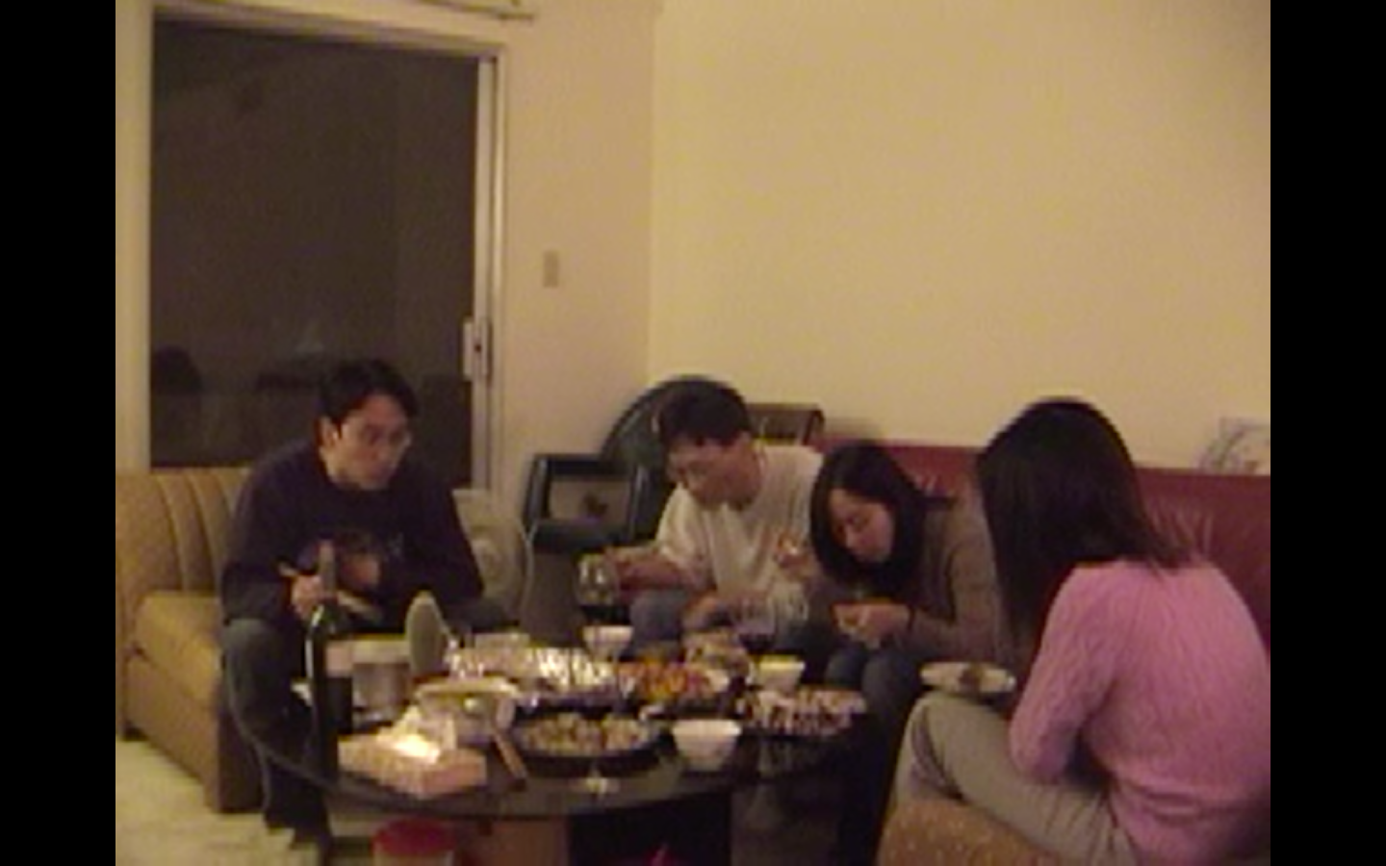
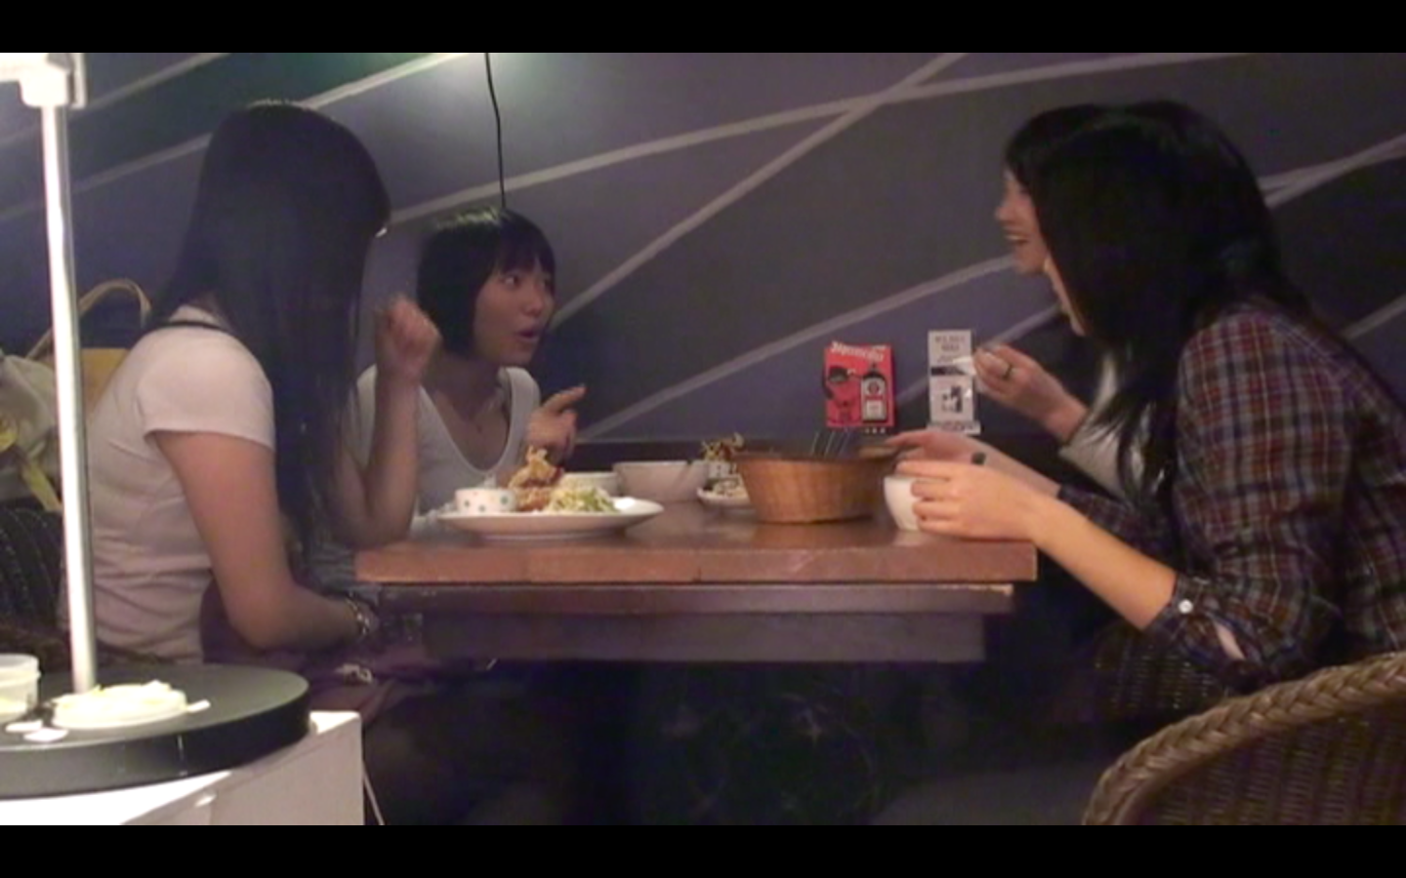
Data
Participants are
    teenagers to people in their thirties
    native speakers of Mandarin Chinese from Taiwan
    Friends and thus familiar with each other (daily casual conversations)
Data come from two resources
  The NCCU Corpus of Spoken Chinese
    An online spoken corpus (http://140.119.172.200)
    six 20- to 30-minute clips (two hours in total)
    6 male and 7 female participants
Mini-corpus of videotaped talk-in-interaction
    Collected from 2005 to 2010
    two one-hour clips (two hours in total)
    2 male and 6 female participants

Slide 12
Why reactive expressions?
Clancy et al. 1996: p. 370
Reactive expressions are believed to be manageable in size and a good starting point to understand listener responses.
In data analysis, some cases involving repetitions are also included and considered.
2nd International Conference on Chinese Spoken Corpora 2016, Rice University

Slide 13
Defining reactive expressions
Deng (2008) defines reactive expressions as “a short free-standing or turn-incipient lexical phrase or word, or an assessment-type non-lexical form, produced by a recipient in reaction to the speaker’s talk” (p.310).
Some tokens (shi and dui for example) are responses to questions as well.
Reactive expressions are specifically defined as “a short free-standing or turn-incipient lexical phrase or word, or an assessment-type non-lexical form, produced by a recipient in reaction to the speaker’s announcements, news delivery, tellings or opinion display. Question-answer pairs are excluded for this analysis.

Slide 14
Identifying reactive expressions
Example 1
Resumptive openers
001 Anne: 喔,我覺得-我沒有去那個公園.
(0.3)
002 Iris: → 喔,你沒去嗎.
003 Anne: → mm.
004 Jack: → 喔,那個公園沒什麼.ehuh[hhh.
005 Anne: → [↑en,真的嗎.
006 Iris: =聽說還蠻[漂亮.
007 Bill: → [不好看.
008 Iris: → [不好看嗎?
009 Anne: → [真的喔.
010 Brad: → ((點頭))˚hen.
011 Jack: 那個公園沒什麼好看.
backchannel
Reactive expressions
Collaborative finishes
Repetitions
repeat questions
Reactive expressions
Reactive expressions

Slide 15
Findings-NCCU & Mini-corpus

Slide 18
Discussion-1
Reactive expressions are commonly constituted by a single lexical word—most often a lexical adjective—and a final particle.
The four words that emerged as those most frequently forming reactive expressions with final particles are 對，是，真的, and 好. For example, 真的/真的啊/真的喔/真的嗎/真的假的。
Others are cognition verbs (知道), evaluative/assessment lexical words (不錯 or 沒錯), adverbs (可能), negation words, or repeat questions.
2nd International Conference on Chinese Spoken Corpora 2016, Rice University

Slide 19
Discussion-2
Different stances are displayed from total agreement, to partial agreement, to confirming or casting doubt.
  The results are consistent with Wu (2001) that when participants are more familiar with each other, they are more likely to display attitudes, particularly casting doubts.
Confirming
Doubting
是喔，是嗎，
真的嗎，為甚麼
不好看嗎? (+repeat)
Total agreement
對對對，沒錯，
是啊，對啊
Partial agreement
也對，也是，
好像是吧，還好啦，可能吧，是沒錯啦
2nd International Conference on Chinese Spoken Corpora 2016, Rice University

Slide 20
Pedagogical implications
Textbook dialogues or teaching materials should closely resemble authentic spoken language (McCarthy, 2002, 2003; McCarthy & Carter, 1994; Ur, 1984).
Incorporating reactive expressions into teaching raises learners’ awareness of the context of language use as well as prepares them to properly play a role as a listener in the spoken interactions.
This study can be seen as part of a growing effort to underscore the importance of integrating findings of the spoken language into communicative teaching projects (Hatch, 1992; McCarthy & Carter, 1994; Tao, 2005).
2nd International Conference on Chinese Spoken Corpora 2016, Rice University

Slide 21
Concluding remarks
This study focuses on reactive expressions in daily casual conversations.
This study attempts to provide an overview of frequent reactive expressions used and to analyze the stances these expressions are used to display.
The findings have shown that reactive expressions are commonly constituted by a single lexical word—most often a lexical adjective—and a final particle. Others could be cognition verbs, evaluative/assessment lexical words, or adverbs.
Different stances are displayed from total agreement, to partial agreement, to casting doubt or confirming.
Future studies:
  To include more data
  To include conversations by mainland speakers and Chinese learners
2nd International Conference on Chinese Spoken Corpora 2016, Rice University

Slide 22
References
Chao, Y. R. (1968). A Grammar of Spoken Chinese. Berkeley: University of California Press.
Clancy, P, Sandra A Thompson, R Suzuki & Hongyin Tao. 1996. The conversational use of reactive tokens in English, Japanese, and Mandarin. Journal of Pragmatics 26. 355-387.
Deng, Xudong. 2008. The Use of Listener Responses in Mandarin Chinese and Australian English Conversations. Pragmatics 18(2). 303-328.
Duncan, S. Jr. M. (1974). On the structure of speaker-auditor interaction during speaking turns. Language in Society, 2, 161-180.
Gardner, R. (1997). The conversation object mm: A weak and variable acknowledging token. Research on Language and Social Interaction, 30(2), 131-156.
Hayashi, M. (2009). Marking a 'noticing of departure' in talk: Eh-prefaced turns in Japanese conversation. Journal of Pragmatics, 41(10), 2100-2129.
Heritage, J. (1984). A change-of-state token and aspects of its sequential placement. In J. Heritage & J. M. Atkinson (Eds.), Structures of Social Action: Studies in Conversation Analysis (pp. 299-345). Cambridge: Cambridge University Press.
Heritage, J. (1998). Oh-prefaced responses to inquiry. Language in Society, 27, 291-334.
Jefferson, G. (1993). Caveat speaker: Preliminary notes on recipient topic-shift implicature. Research on Language and Social Interaction, 26(1), 1-30.
Keevallik, L. (2012). Compromising progressivity: No-prefacing in Estonian. Pragmatics, 22(1), 119-146.
Kim, H. R. S., & Kuroshima, S. (2013). Turn beginnings in interaction: An introduction. Journal of Pragmatics, 57, 267-273.

Slide 23
Sacks, H., Schegloff, E. A., & Jefferson, G. (1974). A simplest systematics for the organization of turn-taking for conversation. Language, 50(4), 696-735.
Schegloff, E. A. (1980). Preliminaries to preliminaries: “Can I ask you a question?”. Sociological Inquiry, 50(3-4), 104-152.
Schegloff, Emanuel A. 1981. Discourse as an interactionai achievement: Some uses of 'uh huh' and other things that come between sentences. In Deborah Tannen (ed.), Analyzing discourse: Text and talk (Georgetown University Round Table on Languages and Linguistics. Washington, DC: Georgetown University Press.
Schegloff, E. A. (1996). Turn organization: One intersection of grammar and interaction. In E. Ochs, E. A. Schegloff, & S. A. Thompson (Eds.), Interaction and grammar (pp. 52-133). Cambridge: Cambridge University Press.
Schegloff, Emanuel A. & Gene Lerner. 2009. Beginning to respond: well-prefaced responses to wh-questions. Research on Language & Social Interaction 42(2). 91-115.
Streeck, J. r. (1995). On projection. In E. Goody (Ed.), Social Intelligence and Interaction (pp. 87-110). Cambridge: Cambridge University Press.
Schegloff, E. A., & Lerner, G. (2009). Beginning to respond: well-prefaced responses to wh-questions. Research on Language & Social Interaction, 42(2), 91-115.
Tao, Hongyin & Sandra A Thompson. (1991). English backchannels in Mandarin conversations: A case study of superstratum pragmatic 'interference'. Journal of Pragmatics 16. 209-223.
Wang, Yu-Fang, Pi-Hua Tsai, David Goodman & Meng-Ying Lin. 2010. Agreement, acknowledgement, and alignment: The discourse-pragmatic functions of hao and dui in Taiwan Mandarin conversation. Discourse Studies 12(2). 241-267.
White, S. (1989). Backchannels across cultures: A study of American and Japanese. Language and Society, 18, 59-76.
Wu, R.-J. R. (2014). Managing turn entry: The design of EI-prefaced turns in Mandarin conversation. Journal of Pragmatics, 66, 139-161.
Yngve, Victor. (1970). On getting a word in edgewise. Chicago Linguistic Society, 6, 567-577.
Young, RF & J Lee. (2004). Identifying units in interaction: Reactive tokens in Korean and English conversations. Journal of Sociolinguistics, 8(3), 380-407.
Zimmerman, Don H. 1993. Acknowledgment tokens and speakership incipiency revisited. Research on Language and Social Interaction 26(2). 179-194.
吳平。（2001）。漢語會話中的反饋信號。《當代語言學》，第三卷2001年第2期，119-126。

Slide 24
Thank you for your attention.
Comments or questions?

