Slide 1

Language Variation in Spanish and the Heritage Learner
Theoretical and Practical Perspectives

Slide 2
Workshop Overview
Theoretical Considerations in the debate over which Spanish to use in the classroom
Options in choosing a Spanish variety to teach
Curriculum design and lesson planning for promoting awareness and knowledge of variation

Slide 3
Theoretical Considerations

Slide 4
Descriptivism’s Legacy
Language and power
A practice-based perspective on standard/non-standard language

Slide 5
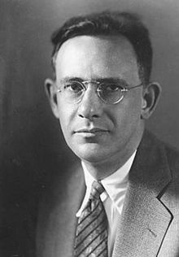
“The lowliest South African Bushman speaks in the forms of a rich symbolic system that is in essence perfectly comparable to the speech of the cultivated Frenchman.”
Edward Sapir
Language

Slide 6
Formal value
Social value

Slide 7

“The competence to produce sentences that are likely to be understood may be quite inadequate to produce sentences that are likely to be listened to, likely to be recognized as acceptable in all the situations in which there is occasion to speak.”
Pierre Bourdieu
Language and Symbolic Capital

Slide 8
The social value of linguistic utterances is
  Unequal
  Determined extralinguistically
  Fitted within “orders of indexicality”
Blommaert, J. (2010). The Sociolinguistics of Globalization. Cambridge: Cambridge UP.
Makoni, S and Pennycook, A., Eds. (2007). Disinventing and Reconstituting Languages. Clevedon: Multilingual Matters.

Slide 9
Deficiencies in current thinking about the social value of language varieties
  Top down, hierarchical notions of power
  Non-negotiability
An alternative view modeled on “contact zones”
  “social spaces where cultures meet, clash, and grapple with each other, often in contexts of highly asymmetrical relations of power” (Pratt 1991)
  Language varieties enter such contact zones and become generative, producing new practices.
Canagarajah, S. (2013). Translingual Practice: Global Englishes and Cosmpolitan Relations. New York: Routledge.

Slide 10
A practice-based perspective on language, ideology and power
  “A focus on language practices moves the focus from language as an autonomous system that preexists its use, and competence as an internal capacity that accounts for language production, towards an understanding of language as a product of the embodied social practices it brings about” (Pennycook 2010).
Pennycook, A. (2010). Language as a Local Practice. New York: Routledge.

Slide 11
Does the language make the speaker or does the speaker make the language?
It is not so much an issue of what import the word “haya” or “haiga” contains, but more an issue of how it is put to work and generated in “contact zones”

Slide 12
How does a practice-based perspective illuminate our thinking about the relationships and interactions between standard and non-standard varieties of Spanish?
  Expectations of correction
  Corrective practices

Slide 13
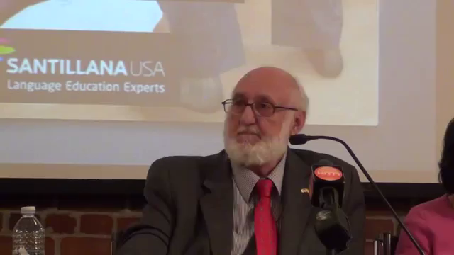
Expectations of Correction
  Debate over Hablando bien se entiende la gente
  Critique
    Negative tone
    Metaphors used to describe non-standard forms
    Outcome
  Response
    Students want to be corrected
Lynch, A & Potowski, K. (2014). La valoración del habla bilingüe en los Estados Unidos: Fundamentos sociolingüísticos y pedagógicos en Hablando bien se entiende la gente. Hispania 97: 32-46.

Slide 14
Ducar (2008) also finds that students “want to be corrected”
  “She takes the time to correct me and make sure my Spanish improves”
  “She respects the way we speak and write, but she also makes us aware that there is a proper way to communicate in the language”
Ducar, C. (2008). Student voices: The Missing link in the Spanish heritage language debate. Foreign Language Annals 41: 415-433.

Slide 15
Corrective Practices
  Example
    “The way my dad talks he’s like – one time, I don´t know where we were at, and my dad goes, “¿Dónde está la línea?” and they looked at him, and they were Mexican immigrants and I went like this and I go, “Dad, it’s not línea.” I said “For a line you don’t say línea.” And he goes, “Yes, you do.” And I say, “No, you say fila.” And then he’ll say “no.”
  How can these practices be interpreted?
    Disrespect?
    Authentication?
Gorman, L. (2015). Ethnolinguistic Contact Zones: Identity and language use within mixed Mexican-Nuevomexicano families in Northern New Mexico. PhD Dissertation. University of Illinois at Chicago.

Slide 16
Re-visioning the dialectic of standard and non-standard languages
  Standard/non-standard is profitably viewed as a practice rather than as a product
  A practice-based perspective accounts for expectations (which are always socially situated and spatialized)
  A practice-based perspective accounts for corrective practices as authenticating activities

Slide 17
Activity and Discussion

Slide 18
Options for teaching a standard variety of Spanish

Slide 19
Traditional Approaches
Eradication
Expansion
Contemporary Approaches
Appreciation
Appropriateness based
Critical

Slide 20
Eradication
A focus on teaching students features of standard Spanish while at the same time eliminating all non-prestige forms present in the students’ linguistic varieties
Course Objective Example:
  Improve learners’ ability to read, listen, write and read in Spanish … Identify the English forms that intrude in the Spanish that is spoken in the United States and find ways to avoid them

Slide 21
Expansion
A focus on developing the learners’ competence in Spanish by focusing exclusively on the standard or academic forms of the language. Although there is no explicit mention of substitution, learners’ varieties are no acknowledged nor do they appear to be valued
Course Objective Example
  Distinguish and apply formal registers of Spanish, in oral and written discourses, with an appropriate level of proficiency”

Slide 22
Appreciation
An additive approach that values language diversity and seeks to add the standard to the learners’ linguistic repertoires. There is an emphasis on making students aware of dialectal differences in the Spanish language.
Course Objective Example:
  Students will be introduced to the main linguistic varieties and cultural patterns of the Spanish speaking world with a special emphasis on the Spanish varieties and cultures in the US

Slide 23
Appropriateness-based
An additive approach that seeks to add the standard to the learners’ linguistic repertoire and (explicitly) teach learners about the appropriate context for use of each linguistic variety or register so that they can modify their language use based on each specific situation
Course Objective Example:
  Be aware of the dialectal differences in Spanish and attitudes towards different varieties. Develop dialectal flexibility in order to use formal and informal varieties according to different social contexts

Slide 24
Critical
Focus on making students’ varieties central to SHL instruction and making students aware of the social and political functions of languages, specifically of Spanish in the United States, in addition to teaching standard forms
Course Objective Example:
  Become aware of dialectal differences in Spanish and the social consequences of their use … develop the dialectal flexibility to use formal and informal varieties of the language according to context and their own choice

Slide 25
Representation of approaches in SHL syllabi

Slide 26
Arguments for the critical approach
  Teacher effectiveness (Correa)
  Student self-perception (Martínez and Villa)
  Community empowerment and social transformation (Leeman)

Slide 27
What factors may have slowed the uptake of critical approaches in SHL instruction?

Slide 28
Consider the following quote from Del Valle:
  “What is crucial from the position I am taking here is less the choice of one particular norm over others than the importance that students be made aware that a choice was made and be equipped with the necessary analytical tools to see the cultural, political, and social context of the choice” (p. 370)
To what extent is this achieved in the critical approach?

Slide 29
Activity and Discussion

Slide 30
Curriculum Design

Slide 31
Community Service Learning
Language for Specific Purposes
Community Based Learning

Slide 32
Community Based Learning
Developing an ethnographic sensibility
Bringing the community into the classroom
  Valuing the community
Academic perspectives inform community behaviors and community norms inform academic perspectives

Slide 33
Community Service Learning
Determining academic objectives in concert with community needs
Developing learning activities that span the classroom and the community organization
Providing opportunities and appropriate elicitation for reflection

Slide 34
Language for Specific Purposes
Determine linguistic needs within the specific domain of activity
Develop opportunities for students to use language within domain
Create opportunities to explore issues of language and power within the domain

Slide 35
An Example: Community based Learning for health care
Spanish for Healthcare Internship experience
  Students were most concerned with communication
    As I sat in front of the computer translating some nutritional diets, I placed my greatest concern on who would be basing their health on what I typed down
  Local varieties legitimized, seen as useful and appropriate
    Thy use the correct measurements in the written diet plan but when I heard them reading a diet plan out loud, they would estimate it in a way the patient would understand … dos cucharitas, medio vasito

Slide 36
Curriculum Development Activity
The purpose of this activity is to develop a lesson plan focused on the acquisition of a prestige dialect
  Decide on a focus – a particular form haya/haiga or a more general topic, such as, exclusionary functions of variation, variation and gender, dynamics of correction, etc.
  Choose an orientation – eradication, expansion, appreciation, appropriateness-based or critical
  Choose an instructional model – community-based learning, community service learning, language for specific purposes, or classroom instruction

Slide 37
Curriculum Development Activity
Develop the lesson plan following these steps:
  Describe the main learning outcome
  Describe how the lesson is set up (background readings, framing lecture, collaborative activities, etc)
  Describe the major components of the lesson
    What do students do?
    With whom do they do it?
    What opportunities do they have for reflection?
    How are those opportunities seized?
  Finally, describe how the components achieve the main learning outcome

